Slide 1
Seeking Funding from
Non-Profit Foundations
September 27, 2023

Slide 2
Today’s Presenter
Office of Foundation Relations
Jara Dorsey-Lash
Associate Director
jed72@psu.edu

Slide 3
Overview
Today’s presentation is meant to provide you with the tools to better target foundation funding through a collaboration with Penn State’s Office of Foundation Relations.
Foundation Fundamentals
Foundation Case Studies and Opportunities
A quick overview of independent foundations and the funding landscape.
Who we are
Proposal Writing
A look at foundations funding in your field and a deeper dive into a couple of the more important funders.
Learn about OFR and how we can help you be successful in your grant applications.
Brief tips for preparing proposal materials, including letters of interest and full proposals.

Slide 4
Office of Foundation Relations
Connecting Penn State faculty and staff with private foundations to advance the University’s research and programmatic strengths and priorities
Our mission is to generate transformative private foundation support for Penn State through the development of mutually beneficial, long-term, collaborative relationships with internal partners and foundation leadership.

Slide 5
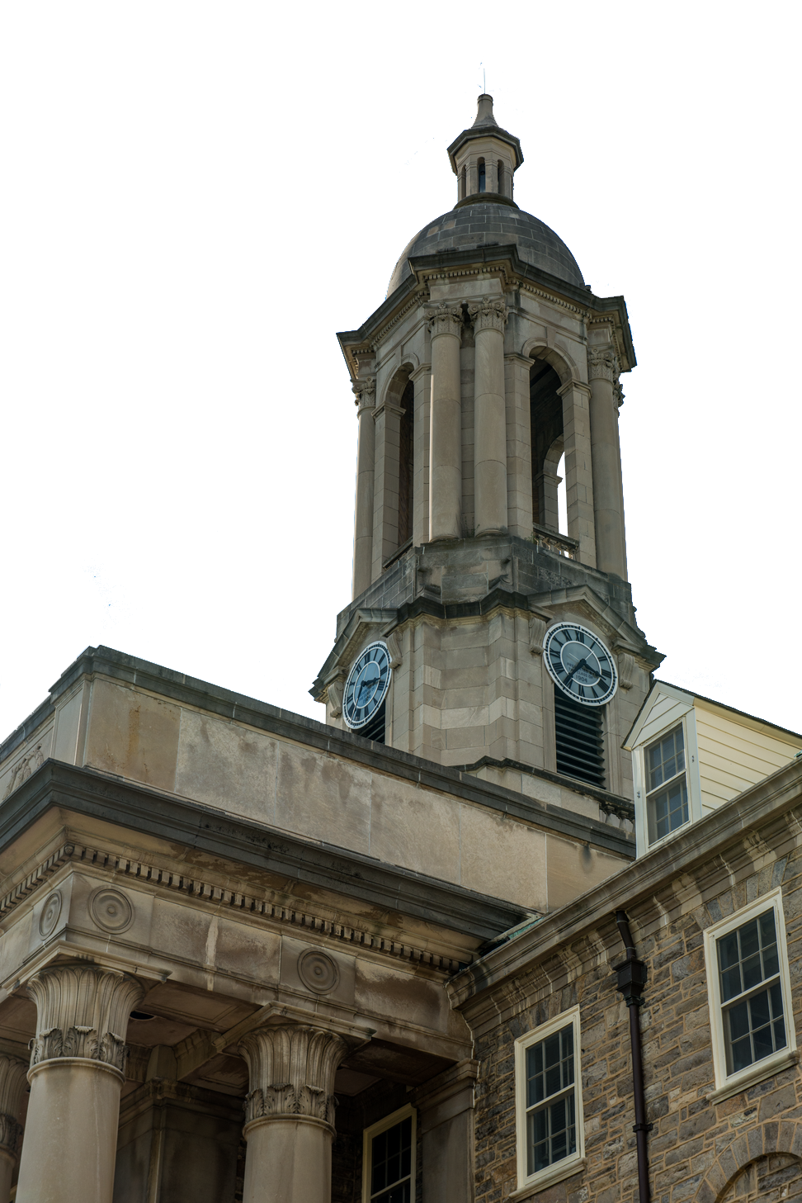
Foundation Insights at Penn State
$126m
Independent foundation giving to Penn State during the most recent capital campaign
240
Number of foundations that made gifts to Penn State during the campaign
Top Foundations
Managed by OFR
Bill and Melinda Gates Foundation The Heinz Endowments Robert Wood Johnson Foundation Richard King Mellon Foundation William Penn Foundation
Arnold Ventures
Ford Foundation

Slide 6
Collaborating with OFR
Ways you can collaborate with the Office of Foundation Relations and find resources to craft successful proposals
InfoReady, Limited Submissions &
Find Funding
Support Resources
OFR Managed Foundations
Research Request Form
LOI templates, proposal development, communication, and more
If interested in a foundation, please check to see if it is an OFR managed prospect and contact foundations@psu.edu.
Not finding an RFP or funder? Please complete the research request form.
Check Infoready, Limited Submissions, and OFR Find Funding page, please reach out to assigned gift officer.

Slide 7
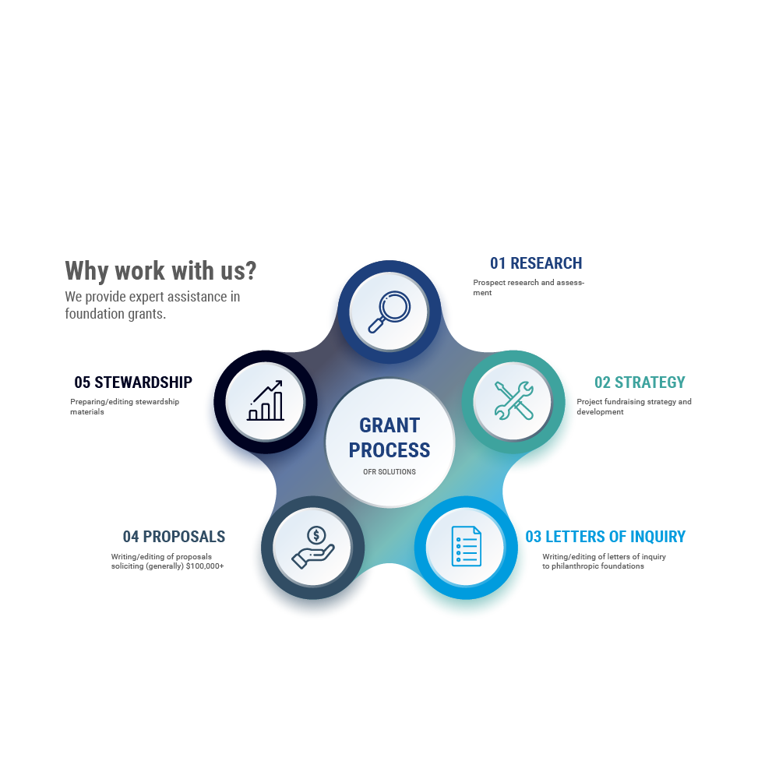
What We Do

Slide 8
How We Work
OFR
OGC
Sets timelines for proposal preparation
4 -6 weeks lead time
Reviews terms and conditions of both the RFP and the submission portal
Develops budget with PI
Routes proposal for institutional signoff
Submits proposal with PI, including F&A waiver
Facilitate relationships between PIs and foundation program officers
Review and edit proposal narratives to ensure that it meets funding criteria and reads to a foundation’s interests
Suggest and introduce collaborators across colleges and campuses to PIs

Slide 9
Types of Foundations
Foundations can be categorized into informal designations that help us understand their structures, funding priorities, and operations.
Independent Foundations​
Family Foundations​
Corporate Foundations (or Company Sponsored Foundations)​
International Foundations​
Private Operating Foundations​
The William and Flora Hewlett Foundation is a nonpartisan, private charitable foundation that advances ideas and supports institutions to promote a better world. The Foundation supported efforts to advance education for all, preserve the environment, improve lives and livelihoods in developing countries, promote the health and economic well-being of women, support vibrant performing arts, strengthen Bay Area communities and make the philanthropy sector more effective.

Slide 10
What Foundations Fund
While every foundation is different, keeping in mind these broad funding trends are useful in determining if your project is a good candidate for foundation funding. Nevertheless, targeted research on individual foundations is key to success.
Mission
Research
Seed
Impact
DEI
Programs and projects that fall within a foundation’s stated mission.
High-reward research projects that help the foundation achieve broad scientific/societal goals.
New, exciting ventures or inventions at start-up phase or seeking to scale.
Programs/projects that have a clearly defined impact on specific populations.
Programs, projects, PIs with a focus on DEI.

Slide 11
What Foundations Don’t Fund
Operations
Scholarships
Individuals
Unclear Impact
Outside Scope
Operating costs and ongoing projects, including established centers
Standalone scholarships and assistantships are generally not funded.
Funding must go through a non-profit entity.
Programs/projects that can’t articulate a clear impact or specific outcomes.
Projects that fall outside of the scope of the foundation’s mission.
F&A
Many foundations will not pay F&A costs or will limit the amount (10-15%).

Slide 12
Proposal Writing
Positioning Your Work for a Foundation RFP
When applying for foundation grants, here are a few tips to help you determine if your project is a good fit for foundation funding. They can also help direct your thinking as you begin preparing letters of inquiry and proposals.
What’s the Problem?
What problems are you trying to solve? Think beyond the problems as they are defined by your field, and consider the broad societal problems and implications that your research will address.
Make sure that the problems you identify align with the foundation’s stated priorities/goals.

Slide 13
Who Benefits the Most
Who are you trying to help? Demographics of your target population are important to articulate, especially intersectional identities (e.g., BIPOC, LGBTQ+, Rural, LI, etc.).
Also, you may want to consider the geographic location of this group. Many foundations limit their giving to support people in specific regions.
Here’s My Solution
Why It Matters
Articulate why your project is the best solution and why you are best situated to solve the problems you address. What makes your project or program unique in solving the problem you identified?
Foundation funding is competitive, and program officers want to know that they are funding the best projects in the best places.
What are the expected impacts/outcomes if implemented?
Make sure that the outcomes you detail match up with the larger societal problems you wish to address. How does your research/project solve this problem? How are your outcomes tied to the target population.

Slide 14
Your Proposal
The Office of Foundations Relations has resources to help you craft your proposal, and our staff is available to help you navigate the proposal process on any foundations that we manage.
Sustainability
Sustainability beyond initial funding?
Generally, foundations will not provide ongoing support for a long-term project. How will you support the project after a grant expires? Also, think about the long-term impacts of your work. Will others be able to replicate your outcomes in other settings to scale up your ideas?

Slide 15
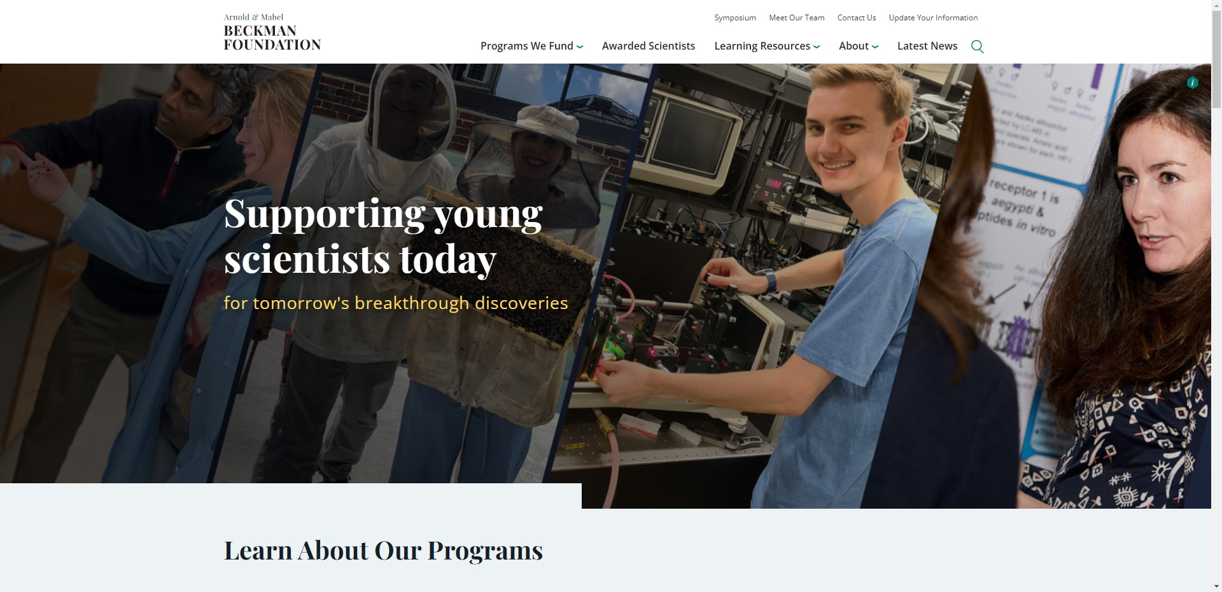
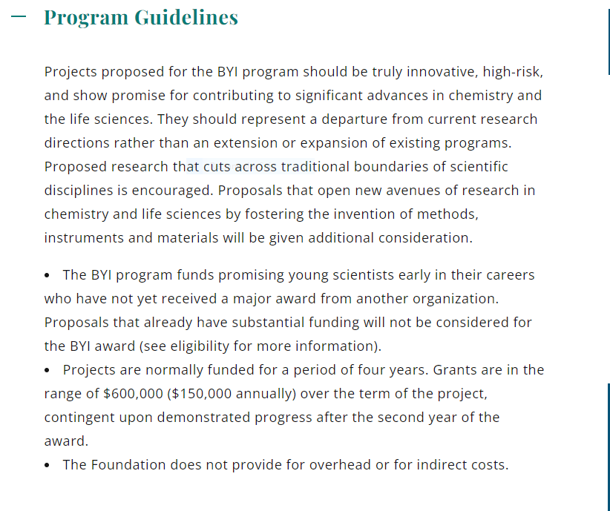
Foundation Case Study
Beckman Young Investigators
Foundation Case Study
ARNOLD & MABEL BECKMAN FOUNDATION
ABOUT THE ARNOLD & MABEL BECKMAN FOUNDATION
The mission of the Foundation is to support leading edge research in the fields of chemistry and life sciences, broadly interpreted, and particularly to foster the invention of methods, instruments, and materials that open up new avenues of research and application in these sciences and related disciplines.

Slide 16
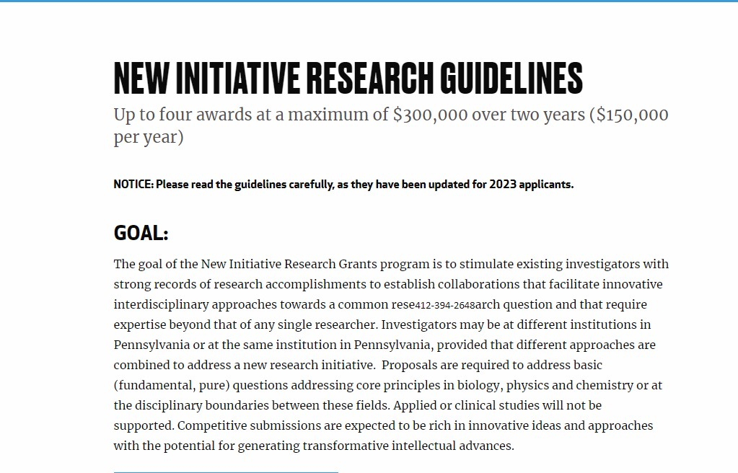
Foundation Case Study
ABOUT THE CHARLES E. KAUFMAN FOUNDATION
The foundation supports fundamental research in biology, chemistry, and physics at Pennsylvania institutions of higher education. Kaufman believed in the potential impact of innovative, curiosity-driven science and the strength of working across interdisciplinary boundaries.

Slide 17
Foundations for Ag Scientists
A few foundations that fund research and projects relevant to agriculture and rural sociology.
Good Food Institute
The David & Lucile Packard Foundation
Alongside scientists, businesses, and policymakers, GFI’s teams focus on making plant-based and cultivated meat delicious, affordable, and accessible.
We champion bold climate solutions, an ocean that sustains us, and scientific innovation and discovery to secure the health and future of people and the planet.
Russell Sage Foundation
The Water Research Foundation
The foundation funds innovative social science research in four principal programs: Behavioral Economics, the Future of Work, Ethnicity and Immigration, and Social, Political, and Economic Inequality.
We fund, manage, and publish research on the technology, operation, and management of drinking water, wastewater, reuse, and stormwater systems – all in pursuit of ensuring water quality improvement and improving water services to the public.
Alfred P. Sloan Foundation
We fund research and education in science, technology, engineering, mathematics and economics.
Schmidt Marine Technology Partners
We support the development of innovative marine technologies that restore and protect the health of our oceans and create sustainable fisheries.

Slide 18
Office of Foundation Relations
Thank You For Attending
If you have any questions or would like to discuss funding opportunities, feel free to contact:
Jara Dorsey-Lash jed72@psu.edu

