Slide 1
College of Agricultural Sciences Internal Grant Programs
August 30, 2023

Slide 2
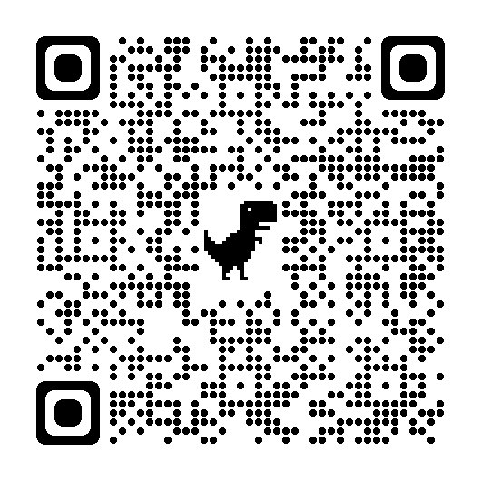
Deep Dive Series – Fall 2023
Civil Rights Compliance for Research
September 7, 2023
Seeking Funding from Non-Profit Foundations
September 27, 2023
The Institute for Sustainable Agricultural, Food, and Environmental Science (SAFES) + Networking Social Event
October 26, 2023
View previous recordings from our Deep Dive Series online at https://agsci.psu.edu/research/resources/professional-development-for-research-series/deep-dive-into-research-series

Slide 3
Research Development Ecosystem
Internal Grants
Proposal Development
Communicate Impact
Research Development is a function that seeks to grow research or increase the research reputation of an institution.
Entrepreneurship & Innovation
Funding Opportunities
Strategic Planning
Competitive Intelligence
Team Science
Corporate Engagement
Training
Concierge Services

Slide 4
Cultivating Research with Internal Grants
Internal grant programs are designed to be strategic tools to position faculty for:
Cross-college collaborations (e.g., network building, career advancement, etc.)
External funding opportunities
Bridge funding to meet critical milestones (e.g., promotion and tenure, research program trajectory, solidifying intellectual property)
Fulfilling state and federal mandate to support agricultural industries in the Commonwealth
Steppingstone to bridge research innovation to societal impact (supporting translation of research discoveries through commercialization, extension, publication, etc.)
Not intended for long-term support

Slide 5
Benefits of Internal Funding Mechanisms
Organize
Seed
Bridge
Team development (i.e., interpersonal dynamics)
Establishing new and solidifying existing networks (e.g., cross-unit collaborations, external stakeholders)
Framing research question
Positioning for external funding (e.g., preliminary data collection)
Feasibility & demonstration (e.g., proof of concept)
Establishing research programs
Reaching critical milestones that open doors to other funding

Slide 6
Programs which Support Faculty Research
COLLABORATIVE RESEARCH & TEAM SCIENCE
ENTREPRENEURSHIP & INNOVATION
ENDOWED PROGRAMS FOR RESEARCH
CAPACITY & OTHER COMPETITIVE GRANTS
Strategic Networks and Initiatives Program (SNIP)
Research Applications for INnovation (RAIN)
Crouch Endowment for Viticulture, Enology, & Pomology Research
McIntire-Stennis Forestry Research
Science to Practice (S2P)
Krueger RAIN Grant for Graduate Students
Woodward Faculty Development or Luerssen Faculty Enhancement
Animal Health and Disease Research
Graduate Practicum in Critical Thinking & Innovation
Nesbitt Program Development Award
Small Equipment Grants
Harbaugh Undergraduate Research Assistantship (HURA)
Sunday Program for Fruit Production Research
Single-Investigator Seed Grants
Rider Endowment for Support of Research Biotechnology of Food Crops
Industry Responsiveness Pilot
Motivating Innovation to Seed Technology (MIST)
Mushroom Research Competitive Grants

Slide 7
Regular Deadlines for Programs
McIntire-Stennis & Animal Health
HURA Summer
SNIP
JUL
AUG
SEP
OCT
NOV
DEC
JAN
FEB
MAR
APR
MAY
JUN
S2P
Practicum Recruitment for Spring
RAIN & Krueger
Endowed Programs
Several programs are announced with deadlines reoccurring each annual cycle (see above)
Rolling deadlines for many of the other programs not listed on the timeline (some may be by invitation only)
We use InfoReady to administer our internal grant competitions

Slide 8
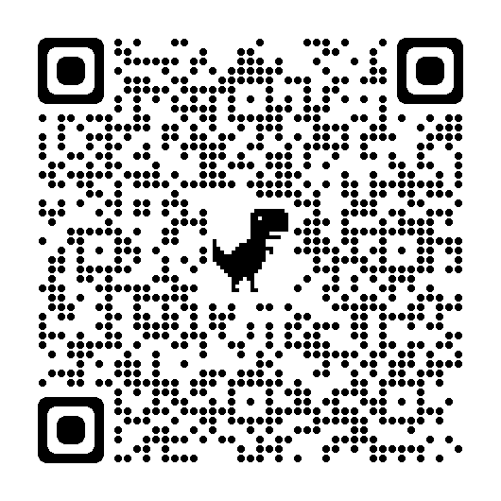
Strategic Networks and Initiatives Program (SNIP)
What is a SNIP grant?
Three levels of funding to meet faculty where they most need support. Competition is held on an annual cycle.
Develops an area of strength in the college for transformative research
Provides funds for network building activities that aren’t usually a part of a grant
Supports teams in the preliminary work toward a large-scale grant that requires an interdisciplinary team
Reinvests the college’s money in supporting faculty research
May target specific research topics
https://agsci.psu.edu/resources/funding

Slide 9
Strategic Networks and Initiatives Program (SNIP)
Level I Launch
Up to $10,000 for one year of support
Initial development of an innovative research question
Establish research trajectory
Refine research goals/objectives
Building an interdisciplinary research team
Identify potential funding sources, promote networking, define the leadership of the collaboration
seminar series, workshops, meetings
Level I Launch
Up to $10,000
for 1 year
Level II Pursuit
Up to $25,000
for 2 years
Level III Cohort
3-5 new
Ph.D. students
for 2 years

Slide 10
Strategic Networks and Initiatives Program (SNIP)
Level II Pursuit
Up to $25,000 for two years of support
Support for established research initiatives
Able to demonstrate ongoing research, clear research goals, and established partnerships
Prepare teams to pursue large-scale extramural funding
Build/organize a core strength in a thematic research area
Sustain national competitiveness
collect preliminary data to strengthen proposal(s)
host symposium or conference to promote networking
plan other activities aimed at submitting a proposal
Level I Launch
Up to $10,000
for 1 year
Level II Pursuit
Up to $25,000
for 2 years
Level III Cohort
3-5 new
Ph.D. students
for 2 years

Slide 11
Strategic Networks and Initiatives Program (SNIP)
Level III Cohort
Sponsor 3-5 Ph.D. students for up to two years
Build an interactive graduate student + faculty team
Minimum of 3 – maximum of 5 newly enrolled Ph.D. students
Integrate graduate education to enhance research in a thematic area
Steppingstone toward extramural funding
Conduct interconnected, innovative research
High-impact synergies among multiple disciplines
Plan for summer and continued support beyond grant
competitive recruitment of graduate students
implement an innovative training concept
build capacity to pursue external funding
Level I Launch
Up to $10,000
for 1 year
Level II Pursuit
Up to $25,000
for 2 years
Level III Cohort
3-5 new
Ph.D. students
for 2 years

Slide 12
Strategic Networks and Initiatives Program (SNIP)
Review Process
SNIP I is reviewed by a panel of faculty who read all proposals and provide recommendations for funding to the Associate Dean for Research
SNIP II is reviewed by two subject matter experts who provide funding recommendations to the Associate Dean for Research
SNIP III is composed a panel that includes college leadership and a previous awardee who provide recommendations for funding to the Associate Dean for Research
Criteria for the evaluations is included in the RFP (hint: these are the questions but reframed as sentences)

Slide 13
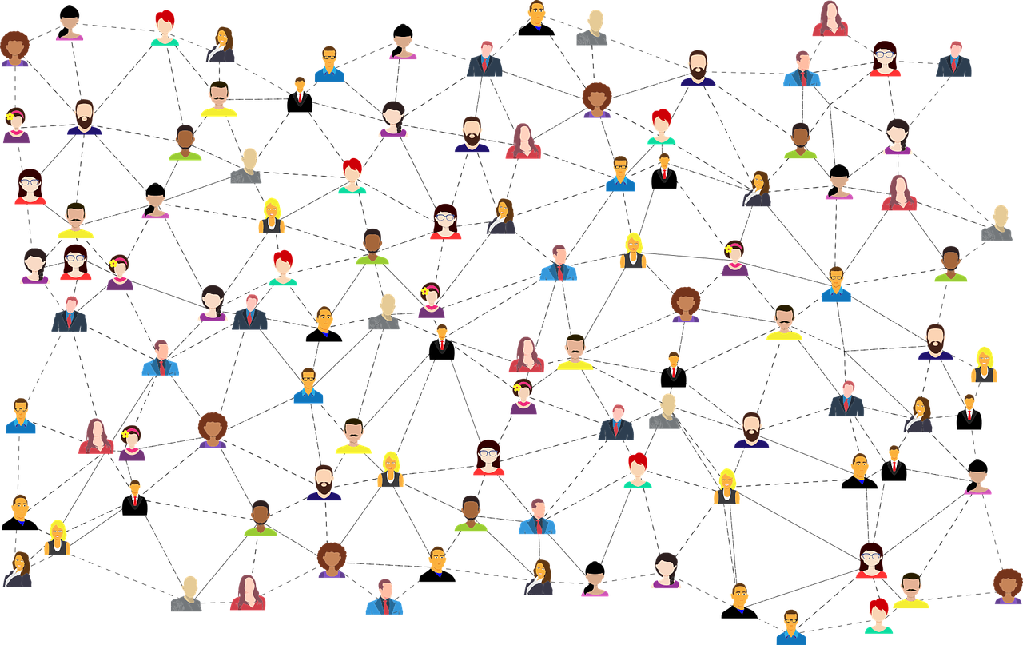
Strategic Networks and Initiatives Program (SNIP)
Impacts
From 2017 – 2020, eight SNIP teams secured a total of $12,423,417 in extramural grants directly related to their SNIP projects
Expansions at the University level:
The Phytobiome team (SNIP 2015-2016) developed into the Microbiome Center, now a thriving group under the Huck Institutes of the Life Sciences
The Roots team (SNIP I 2019-2020, SNIP II 2020-2021) has formed the Center for Root and Rhizosphere Biology under the Huck Institutes
The Genomic Resources team (SNIP II 2018-2019) has formed the Center for Parasitic and Carnivorous Plants under the Huck Institutes

Slide 14
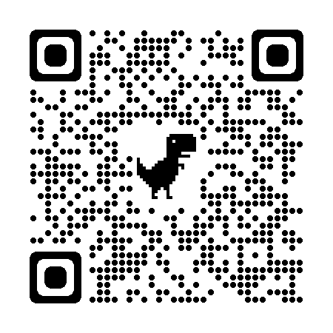
Science to Practice (S2P)
RESEARCH
What is a S2P grant?
A collaborative internal grant program with Penn State Extension, using a portion of our federal appropriations (Hatch and Smith Lever) to distribute competitively
Supports projects that integrate research and extension
Prioritizes proposals that creatively leverage the strengths of each function to address pressing, complex challenges that require multiple perspectives and modes of knowledge
Encourages the growth of transdisciplinary collaborations beyond the university
S2P
EXTENSION
https://agsci.psu.edu/resources/funding

Slide 15
Science to Practice (S2P)
RESEARCH
Open NOW – deadline is 9/5/2023
Up to $10,000 awarded to teams for one year
Award is split between Research and Extension activities
A research PI (must lead a Hatch project) and an extension PI (must have an extension appointment in the college)
Teams can apply for renewal up to two additional times for the same project
Competition opens in summer (ideally in late May) and closes in early September
S2P
EXTENSION

Slide 16
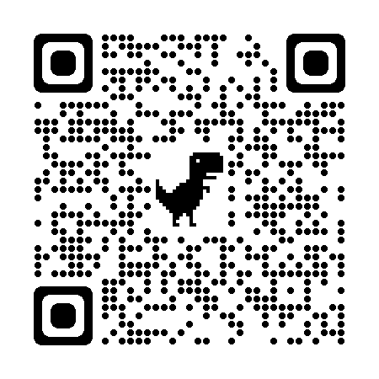
Research Applications for INnovation (RAIN)
What is a RAIN grant?
Helps investigators take steps towards commercializing their research:
To overcome hurdles faced in the process (ex: regulatory expenses)
To validate commercial application of a technology (ex: scaling from bench to pilot)
To strengthen the IP position with further testing and data collection
Funding presumes there is Penn State intellectual property which will eventually be licensable
https://agsci.psu.edu/resources/funding

Slide 17
Research Applications for INnovation (RAIN)
Review Process
Proposals are reviewed by two sets of reviewers:
Scientific subject experts who weigh in on the feasibility of the proposed scope of work
Commercial experts who evaluate the commercial potential of the technology
A review panel of the commercial experts and the Entrepreneurship & Innovation Team meet to discuss all proposals and provide funding recommendations to the Associate Dean for Research

Slide 18
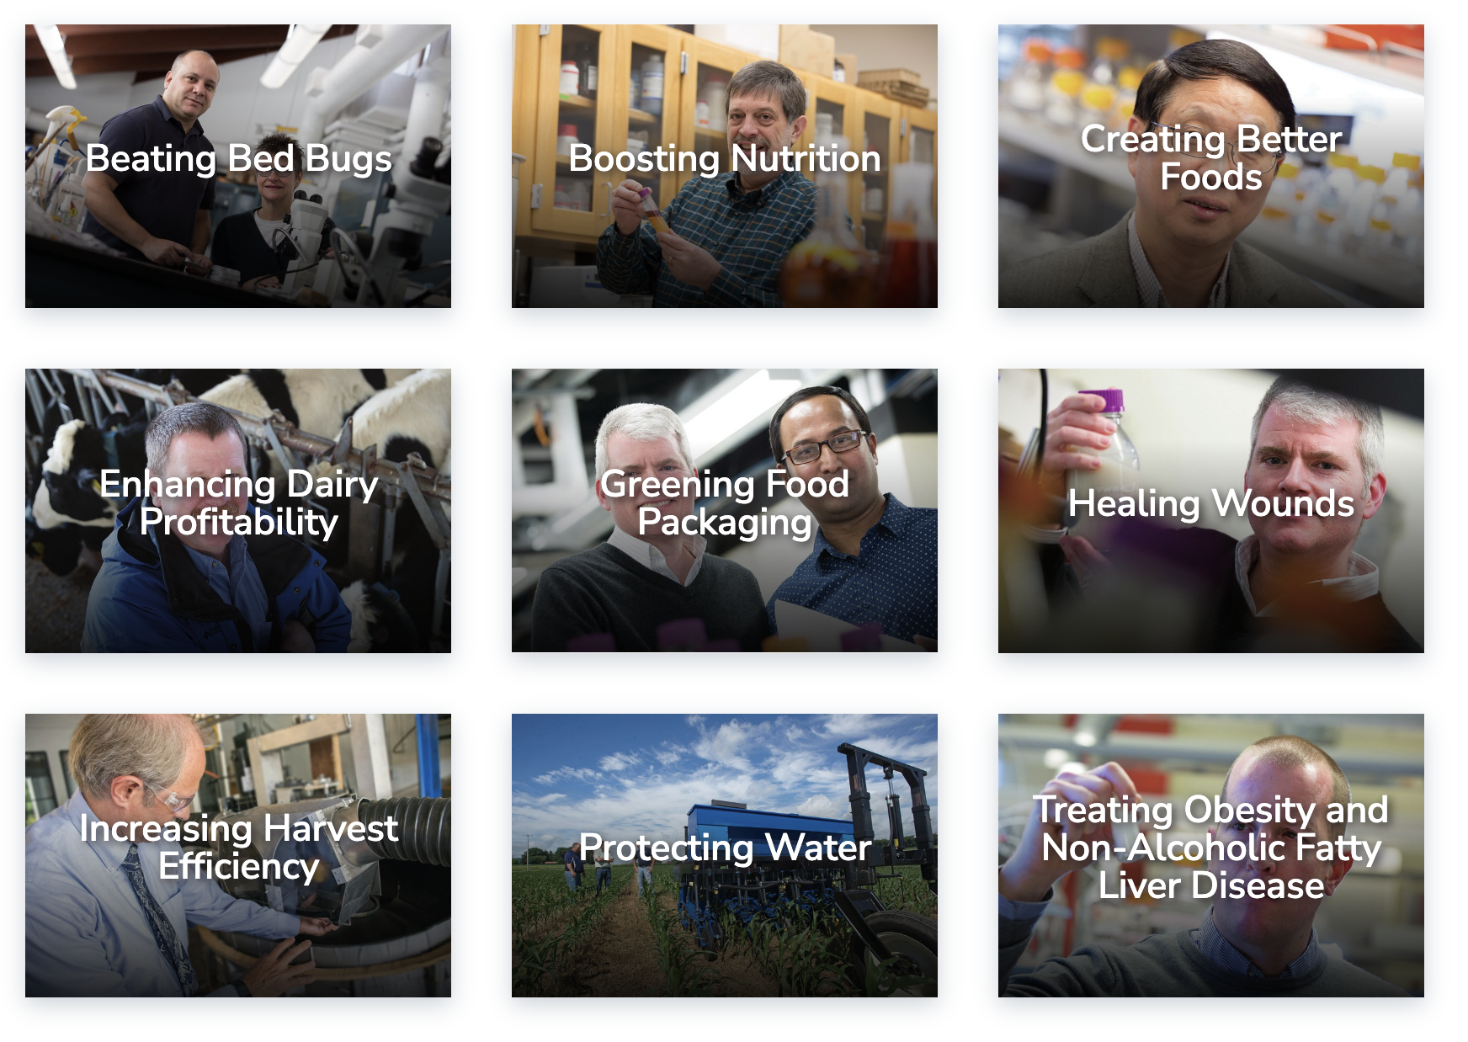
Research Applications for INnovation (RAIN)
Impacts
Conidotec (2013 RAIN grant)
Immunogreen (2022 RAIN grant)

Slide 19
Krueger RAIN Graduate Student Grant
Supports RAIN projects with significant graduate student involvement. Can be applied for independently or in combination with traditional RAIN grant funding.
These funds (up to $32,000) may be used for research activities, support a graduate assistantship for up to one year (budgets must include fringe expenses), or any combination of these expenses.
Funding presumes there is Penn State intellectual property which will eventually be licensable
Past Project Examples:
Edible starch scaffolds for cell ag (2021 RAIN grant)
Biodegradable Coatings (2023 RAIN grant)

Slide 20
Harbaugh Undergraduate Research Assistant (HURA)
Supports faculty research projects which can involve undergraduate students as research assistants.
These funds (up to $4,500) may be used for wage payroll expenses (up to $15/hr), plus 10% for associated research expenses (ex: materials, PPE).
Funding presumes the student will participate in entrepreneurship and innovation training provided by program faculty advisor, Mark Gagnon.
Past Project Examples:
High Flavonoid Corn and Poultry Enteritis (2020 grant)
Cellular Redox Therapies for Leukemia (2021 RAIN grant)

Slide 21
Graduate Practicum in Innovation & Critical Thinking
This professional development course pairs graduate students with industry mentors and innovation projects.
Funding of up to $5,000 is available to support project expenses that provide professional development value to students.
The course can be offered for 1, 2, or 3 credits.
Innovation projects may focus on industry-based innovation, or on the commercialization of research from the student's academic lab.
Past Project Examples:
Xinova Rapid Innovation Sessions (2020 – 2022)
Sysco/Google/Cargill ReSkued Food Waste Reduction (2023)

Slide 22
Motivating Innovation to Seed Technology (MIST)
This invitation-only course enables early-stage work that is likely to generate valuable intellectual property for Penn State.
An invention disclosure is typically required before a project can be invited to apply for MIST funding.
Project funding is typically up to $10,000 and can be used for various expenses relevant to establishing a strong IP position (ex: testing, lab supplies, etc.)
Note: This program has very limited funding.
Past Project Examples:
RAIN Grant Prep (High Flav Corn, Immunogreen, Redox Therapy)
Tech Advancement Pilot Prep (flourine-free waterproofing)
This program is by invitation only

Slide 23
Industry Responsiveness Pilot
Supports faculty research projects which are ready for and in need of industry collaboration for commercial success.
These funds (up to $10,000) may be used to demonstrate technologies and meet critical industry-specified milestones on the path to research commercialization.
Funding presumes consultation and direction from the Entrepreneurship and Innovation Program faculty and staff.
Past Project Examples:
Florine-free Textile Waterproofing (2022)
Mycelium production for Commercial Applications (2023)
This program is by invitation only

Slide 24
Endowed Programs for Research
Funding that is generated through interest earned on endowments established by donors to the college
Programs tend to have strict guidance on the types of research that can be supported
Competitions are held annually, opening in early spring and due by mid- to late May
Review Process
Proposals are reviewed by a panel of college faculty members (may or may not be experts) who read all proposals and provide funding recommendations to the Associate Dean for Research

Slide 25
Endowed Programs for Research
Mushroom Research Competitive Grants
Supports mushroom research broadly defined (processing, packing, composting, pathology, strain research, entomology, disease control, spent substrate research, food safety, post-harvest handling, product development and marking and mushroom physiology.
Crouch Endowment for Viticulture, Enology, & Pomology Research
The purpose of these funds are to support research in Viticulture, Enology, or Pomology and to support students studying in these areas.
Woodward Faculty Development or Luerssen Faculty Enhancement
The purpose of these two endowments shall be to provide supplementary funds to support professional development and programs for full-time faculty members with the rank of Assistant Professor.
Nesbitt Program Development Award
The purpose of this endowment shall be to support a College of Agricultural Sciences faculty member focusing on dairy in their teaching or extension programs, with the intent that the investment will help the awardee leverage future funding opportunities in any or all of these functional areas, for Animal Science or Food Science.
Sunday Program for Fruit Production Research
The purpose of this endowment shall be to enrich the College of Agricultural Sciences by providing monies for fruit production research.
Rider Endowment for Support of Research on Biotechnology of Food Crops
The purpose of this endowment shall be to support College of Agricultural Sciences faculty in their biotechnology research and teaching programs that give promise of improving upon food crop production and quality while protecting the quality and safety of the environment.

Slide 26
Competitive Capacity Grants
Some of the capacity funding that comes to the college from USDA NIFA is distributed competitively
Capacity awards must be awarded in conjunction with an approved USDA NIFA Agricultural Experiment Station project
Review Process
Proposals are reviewed by external subject experts who provide recommendations for funding to the Associate Dean for Research / Director of the Agricultural Experiment Station

Slide 27
Competitive Capacity Grants
Animal Health and Disease Research
A grant opportunity to support research that includes:
Promotion of the general welfare and health of animals
Facilitation of treatment and prevention of diseases
Protection of human health
Competition runs as funds are available
McIntire-Stennis Forestry Research
A grant opportunity to support forestry research that includes:
Reforestration and management of land
Management of forest and related watershed lands
Management of forest and related rangeland
Management of forest lands for outdoor recreation
Protection of forest land and resources
Utilization of wood and other forest products
Development of sound policies for management of forest lands
Competition runs annually

Slide 28
Prospective Competitive Research Grants
Small Equipment Grants
Competition held as funds allow
Goal is to hold an annual competition
Keep an eye out for upcoming competition!
Research Seed Grants
Considering the possibility of running single-investigator seed grants
Stay tuned!

Slide 29
Questions

