Slide 1
Agricultural Experiment Station
March 22, 2023

Slide 2
What is the Agricultural Experiment Station?
Projects
Requests to submit a project proposal or join an existing Hatch or Hatch Multistate project
Considered or have submitted a proposal for McIntire-Stennis or Animal Health and Disease Research funding
Requests to submit results reports every year through the NRS
Requirement to cite your AES project number (4###) and accession number on publications as an acknowledgement of funding sources
Used the facilities at our Research and Extension Centers: FREC (Biglerville), SEAREC (Landisville), or LERGREC (Erie)
Reporting
Funding
Capacity

Slide 3
What is the Agricultural Experiment Station?
Responsibility and Obligation
Historical Context
Projects
Reporting
Funding
Capacity
How we came to be…
What we are collectively contributing…

Slide 4
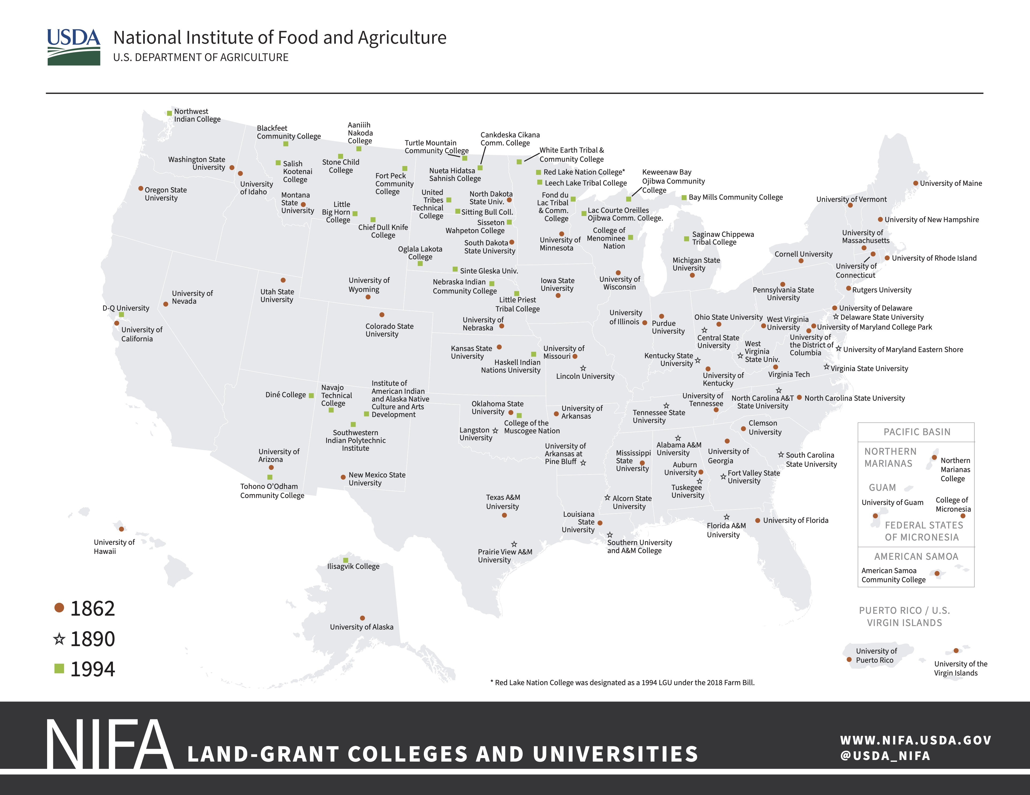
Land-Grant Colleges and Universities (LGU)
Penn State, as the sole land-grant institution in the Commonwealth, received a total of almost $23 million in federally appropriated capacity grants in fiscal year 2023 (research and extension).
Funds are allocated to each LGU based on statutory formulas established by Congressional acts (e.g., Hatch, McIntire-Stennis, Smith-Lever).
Funding has essentially stayed flat over the past decade, meaning that when accounting for inflation, the amount is actually declining
Total LGU Capacity Funds

Slide 5
Federal Capacity Grants and
Pennsylvania Agricultural Land Scrip Funds
Agricultural Experiment Station
Penn State Extension

Slide 6
Research Capacity Grant Programs
trend across the last several years in federal appropriations
Penn State is eligible to receive capacity funding to support four research programs established by legislation over the past 136 years:
Hatch
Hatch Multistate (25% of the total Hatch allocation)
McIntire-Stennis
Animal Health and Disease Research
Only three universities received more Hatch funding than Penn State in FY22:
Texas A&M
North Carolina State
Ohio State

Slide 7
Research Capacity Grant Programs
allocated to the Pennsylvania Agricultural Experiment Station through USDA National Institute for Food and Agriculture
$8,063,943
90%
$794,764
$1,811,996
$56,793
9%
1%
Hatch
Hatch
Multistate
McIntire-Stennis
Animal Health and Disease Research
single or multi-investigator projects
cover a broad spectrum of agricultural research addressing challenges at the local, state, regional and national levels
majority of faculty in the college participate in a Hatch project
multidisciplinary projects that coordinate research concerning more than one state or a region
require jointly planned, cooperative efforts that integrate activity of the participants, include multidisciplinary approaches, and are mutually beneficial to the states involved
competitively awarded
address a wide range of forest research topics pertaining to management, protection, and utilization of state forests
competitively awarded
address a number of animal health concerns, including the general welfare and productivity of income-producing animals, as well as disease prevention for both animals and humans
Learn more: https://agsci.psu.edu/inside/knowledgebase/research-support/aes-resources/capacity-grants

Slide 8
AES Plan of Work and Current Research Projects
administered by AES staff in the Office for Research and Graduate Education
83
Critical Issues
Pennsylvania Agricultural Experiment Station
147
6
Active AES Projects
Critical issues submitted as a part of the Plan of Work
51
~250
~130
Faculty with research appointments
Research FTEs in the college
11
2
Blair Siegfried, Director of the Pennsylvania Agricultural Experiment Station

Slide 9
New faculty hired with a research appointment
AES coordinator is notified that the new faculty member must be on an AES project within 12 months of start date
Faculty member submits a new Hatch proposal for a 5-year project
Lead faculty submit results reports annually through NRS
Internal review of the proposal by department heads, peer reviewers, and AES staff
New Hatch Project Life Cycle
administered by AES staff in the Office for Research and Graduate Education with departmental AES Coordinators
Submission to USDA NIFA for review and approval
Final approval by Director of the Ag Experiment Station
Learn more: https://agsci.psu.edu/inside/knowledgebase/research-support/aes-resources/proposals

Slide 10
AES Administration and Obligations
administered by AES staff in the Office for Research and Graduate Education and individual departments
Annual Report of Accomplishments and Combined Research and Extension Plan of Work (POW)
Beginning of Federal Fiscal Year
Financial Reports
Research Results and Extension Results
End of
Federal Fiscal Year
October
January
February
March
April
September
FBO and RGE work on financial report
RGE leads effort to collect results reports in NRS from AES faculty
RGE works with external consultant to write annual report and POW
As a land-grant institution and home to the Pennsylvania Agricultural Experiment Station, our obligation to the US government and citizens is to report on:
Our stewardship of the appropriated funds, including documentation of the required 1:1 match from non-federal sources per the Hatch Act of 1887 (7 U.S.C. 361c(d)(1))
Our alignment with “high-priority concerns with national or multistate significance”— per the Agricultural Research, Extension, and Education Reform Act of 1998 — for future and completed research and extension activities
Learn more: https://www.nifa.usda.gov/data/nifa-reporting-system

Slide 11
Agricultural Experiment Stations
Land-Grant
Hatch
Land Scrip
McIntire-Stennis
USDA NIFA
Animal Health
Capacity Grants
Smith-Lever

Slide 12
Agricultural Experiment Stations
Land Scrip
Land-Grant
USDA NIFA
1855
2023
Capacity Grants
Hatch
Animal Health
Smith-Lever
McIntire-Stennis

Slide 13
Agricultural Experiment Stations
Land Scrip
Land-Grant
USDA NIFA
Capacity Grants
Hatch
Animal Health
Smith-Lever
McIntire-Stennis

Slide 14
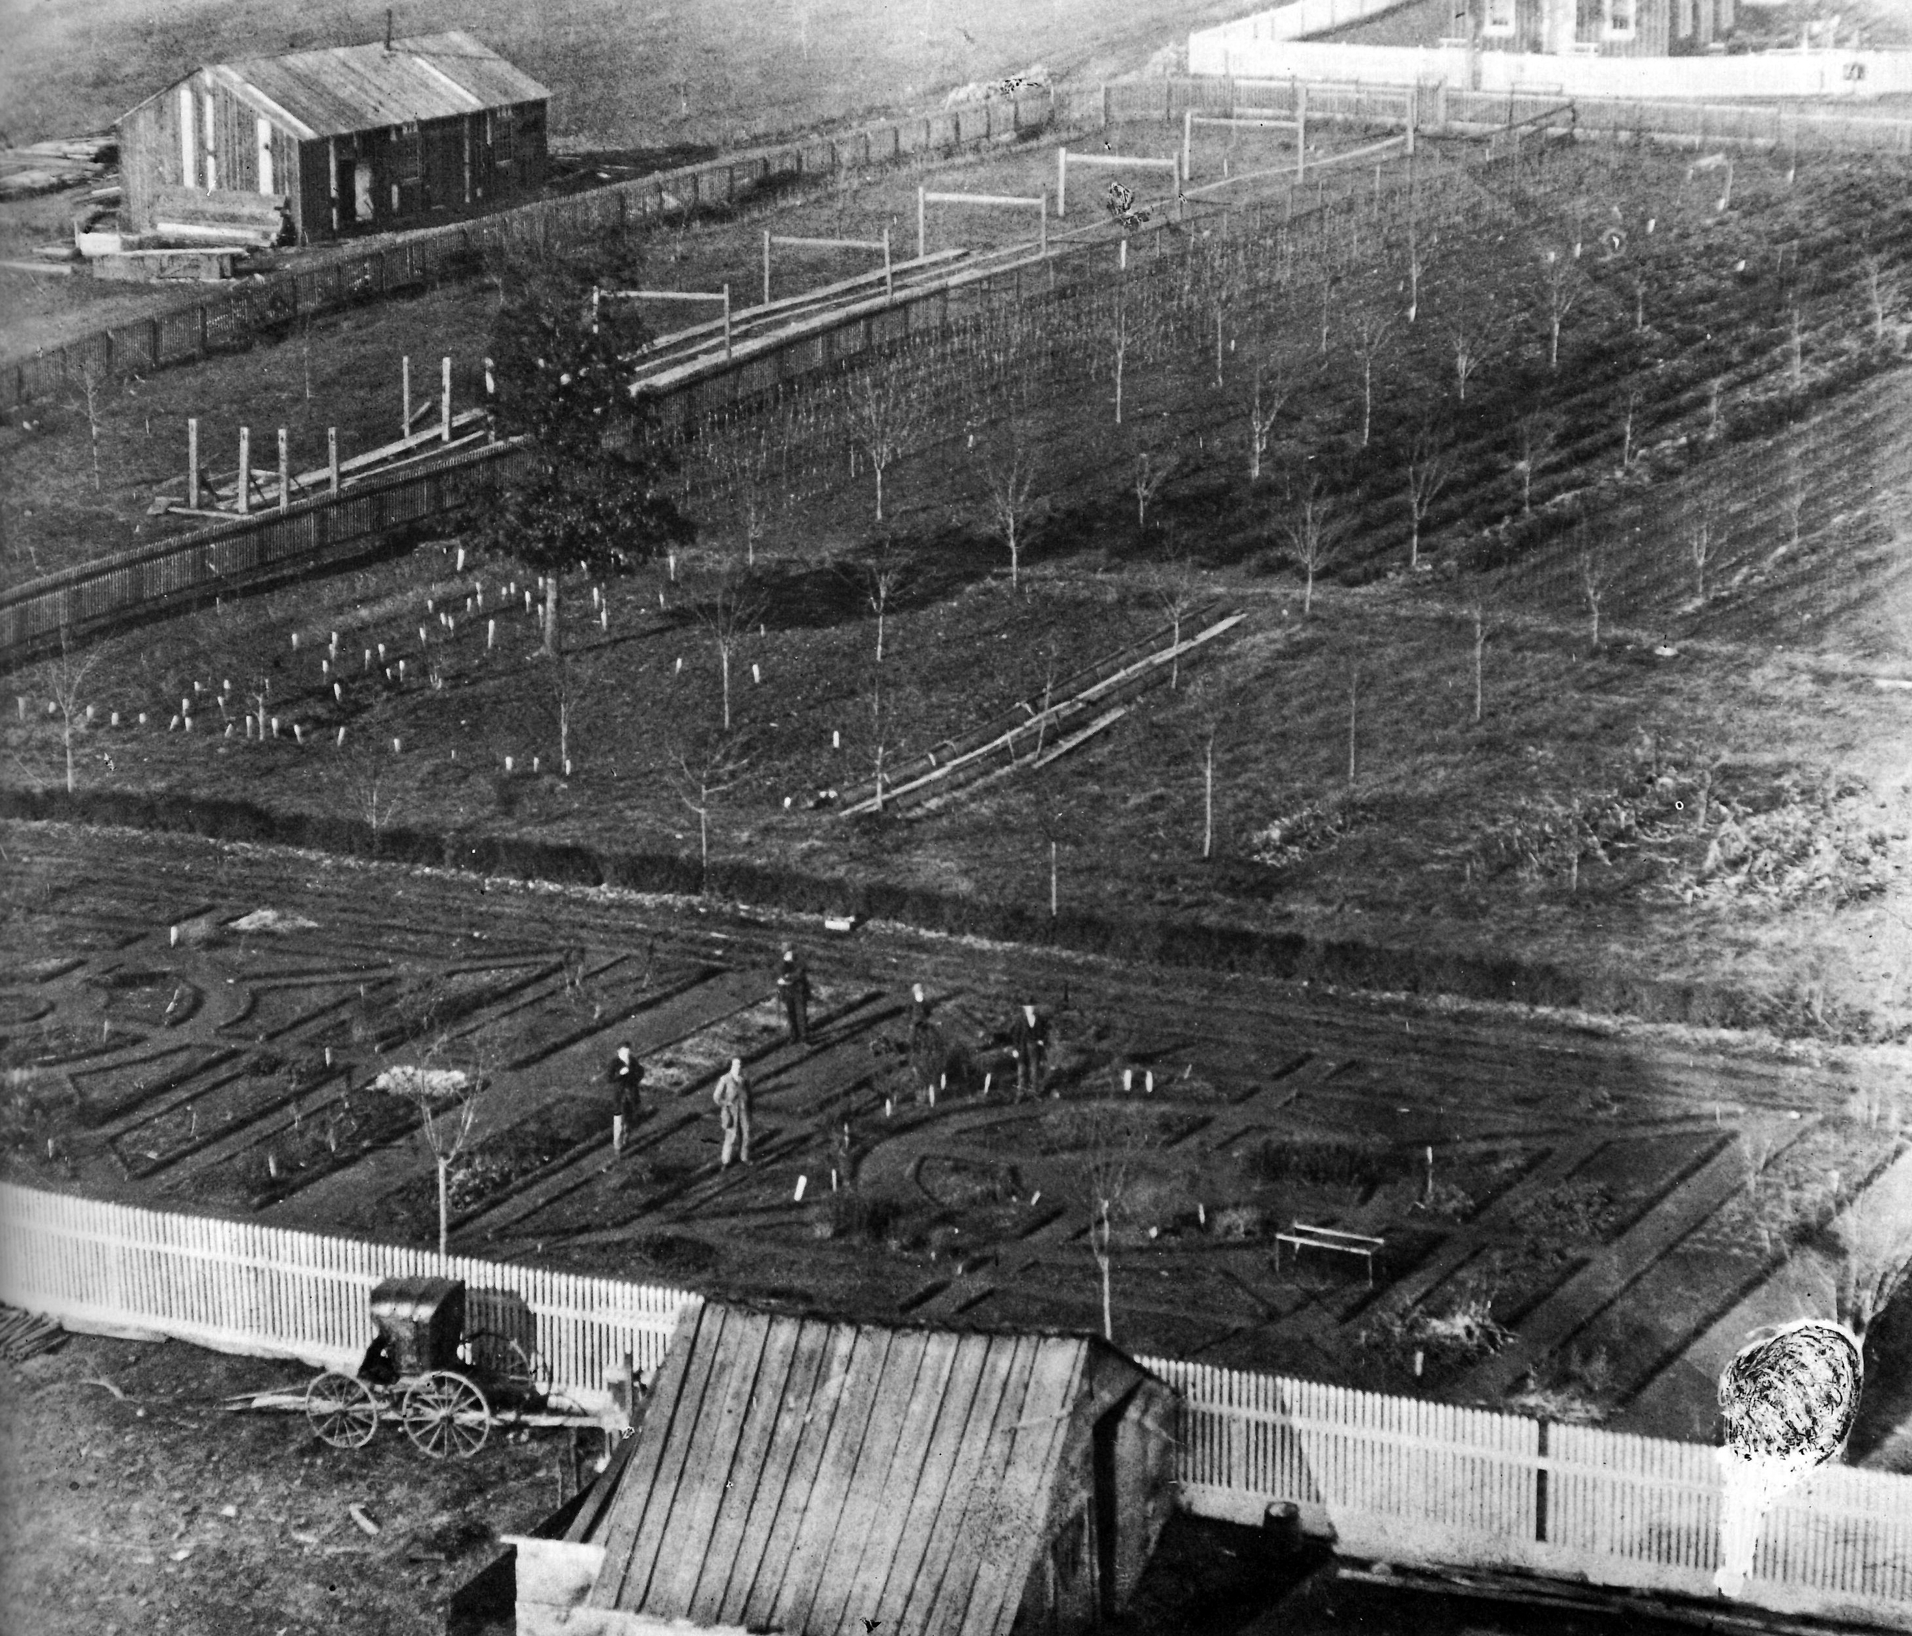
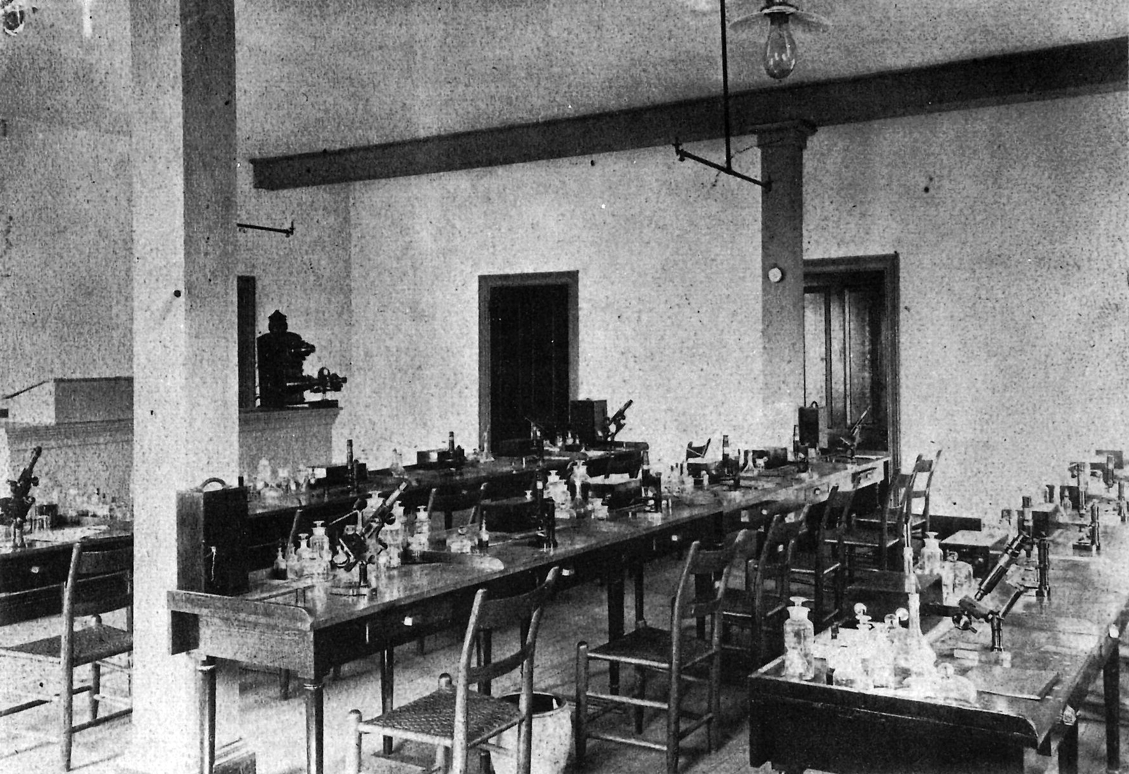
Agricultural research at the core of the institution
Formal gardens behind Old Main (1865). Bezilla, The College of Agriculture.
The Farmers’ High School was founded on the premise that agricultural science and research would help to propel a growing agricultural nation
Happening at a time when there was a larger movement spearheaded by agricultural societies across the growing nation to expand agricultural production and to settle western states and territories
The institution’s first president — Evan Pugh, a chemist by training — was integral to that vision, basing his advocacy on European examples he had witnessed
Differed from other agricultural college programs at the time, which were largely based in learning practical applications
The name chosen for the institution reflected tensions between “book farming” and farming by experience, a debate that would continue for another 100+ years
Botany laboratory in Old Main (1880). Bezilla, The College of Agriculture.

Slide 15
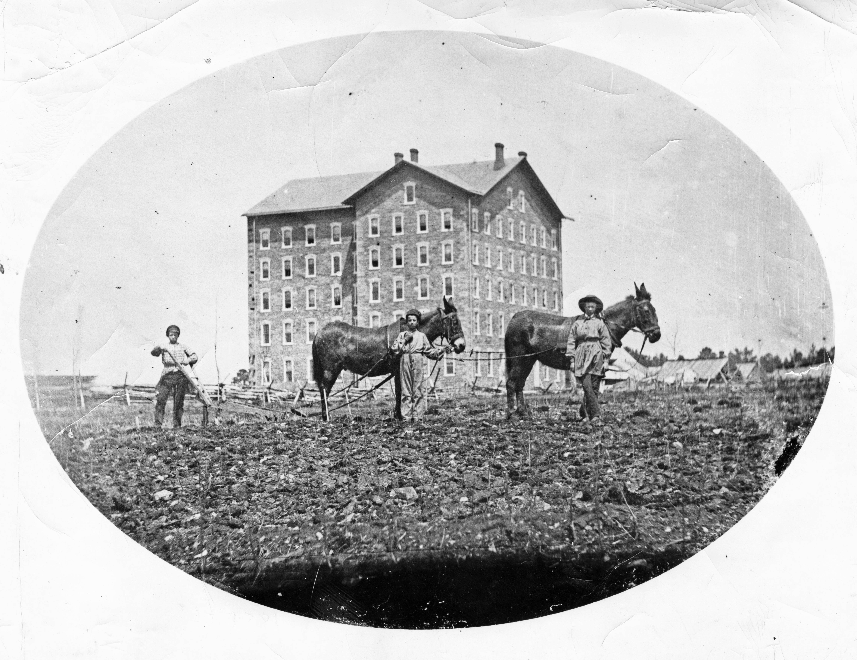
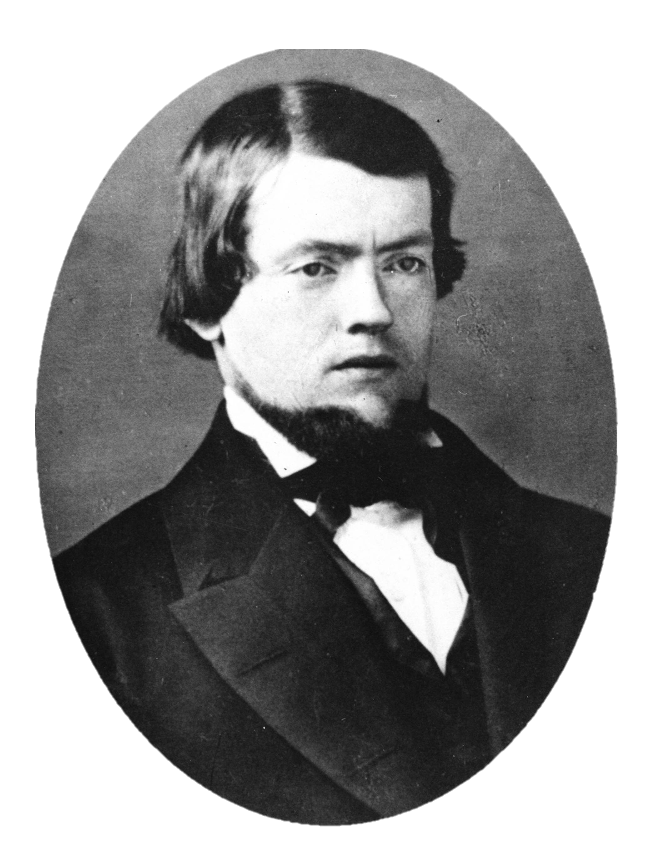
Beginnings of the Farmers’ High School
1853
Early efforts to charter a new Farmers’ High School, pointing out in early advocacy that farmers “have never derived any advantage from the large appropriations which have been made by the Legislature to the several colleges of the State”
1854
1855
On February 22, governor signed into law a new act of incorporation establishing the Farmers’ High School with a contentious site selection debate following in the next few years
Old Main (1857-63), shown in 1859 (Penn State University Libraries Special Collections Online)
1859
The first college catalog issued in February outlines the institution’s mission “to afford a system of instruction as extensive and thorough as the usual course of our best colleges, to emphasize scientific instruction, and to develop to the fullest extent possible those departments of all science which have a practical or theoretical bearing upon agriculture and agricultural interest”; Evan Pugh accepts position while finishing his Ph.D. in chemistry at University of Göttingen, Germany
Evan Pugh (1828-64), President (1859-1863) (WikiCommons)

Slide 16
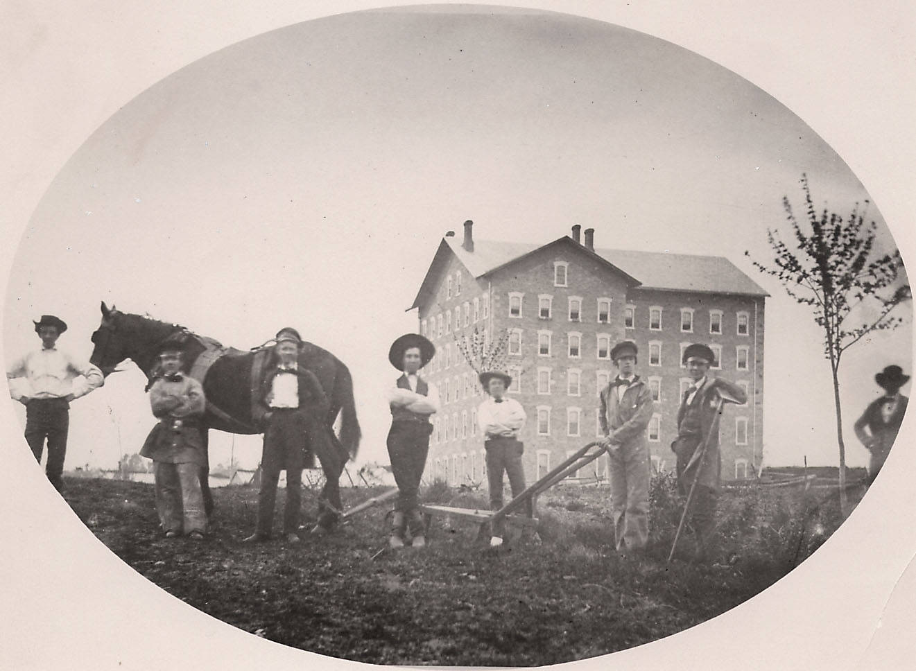
Becoming the Agricultural College of Pennsylvania
1860
Pugh pushed his case for a national system of agricultural science and education, based on the model of the Farmers’ High School – he believed a foundational component should be agricultural experiment stations like those he’d seen in Germany
1861
Eleven southern states secede from the Union, Abraham Lincoln is sworn in as President, and first battles of the Civil War are fought
1862
Name of the Farmers’ High School is changed to the Agricultural College of Pennsylvania;
Pennsylvania congressmen are instrumental in the passage of the Morrill Act, which was signed into law on July 2
Lincoln signs into law the establishment of the US Department of Agriculture, although it is not granted cabinet status until 1889
1863
The Pennsylvania governor signed into law the Commonwealth’s adoption of the Morrill Act on April 1
Old Main (1857-63), shown in 1863 (Penn State University Libraries)

Slide 17
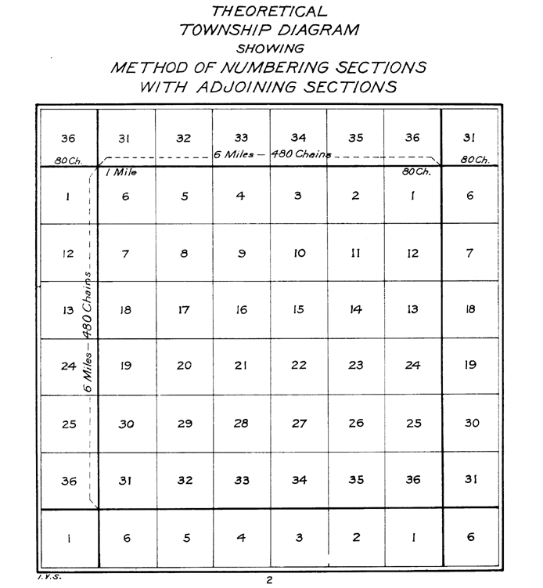
The Morrill Act of 1862
Failed in first attempt to pass the legislation in 1857
The act was based in an established practice of the government setting aside land to sell for the establishment of public education (as with the Land Ordinance of 1785, which set aside the 16th section of each ”township” to be sold to fund an endowment for a local school)
The Morrill Act apportioned to each state that accepted/adopted the terms of the act 30,000 acres per US senator and congressional representative
Based on the Census of 1860, Pennsylvania had 24 representatives and 2 senators, entitling the state to 780,000 acres
The land was granted as “scrip” (essentially a certificate for federal public lands) to be sold by each state
Pennsylvania, like many other states, struggled to sell the land on a flooded market, but eventually sold all scrip by 1867 for an average of 56 cents per acre
“An Act donating Public Lands to the several States and Territories which may provide Colleges for the benefit of Agriculture and the Mechanic Arts”

Slide 18
Land Grant Acts in the United States
May 20, 1862
Homestead Act
Provided 160 acres of federal public land to anyone who agreed to reside on the land for 5 years
A total of 84,000,000 acres set aside
July 1, 1862
Pacific Railway Act
Authorized the construction of a transcontinental railroad through sale of federal public land
A total of 127,000,000 acres set aside
July 2, 1862
Morrill Act
Granted federal public lands to states for the purpose of establishing colleges for agriculture and the mechanic arts
A total of 17,400,000 acres set aside
Atlas of the Historical Geography of the United States. By Charles O. Paullin, Carnegie Institution of Washington. Edited by John K. Wright, Librarian, American Geographical Society of New York. Published Jointly by Carnegie Institution of Washington and the American Geographical Society of New York, 1932. (David Rumsey Map Collection)

Slide 19
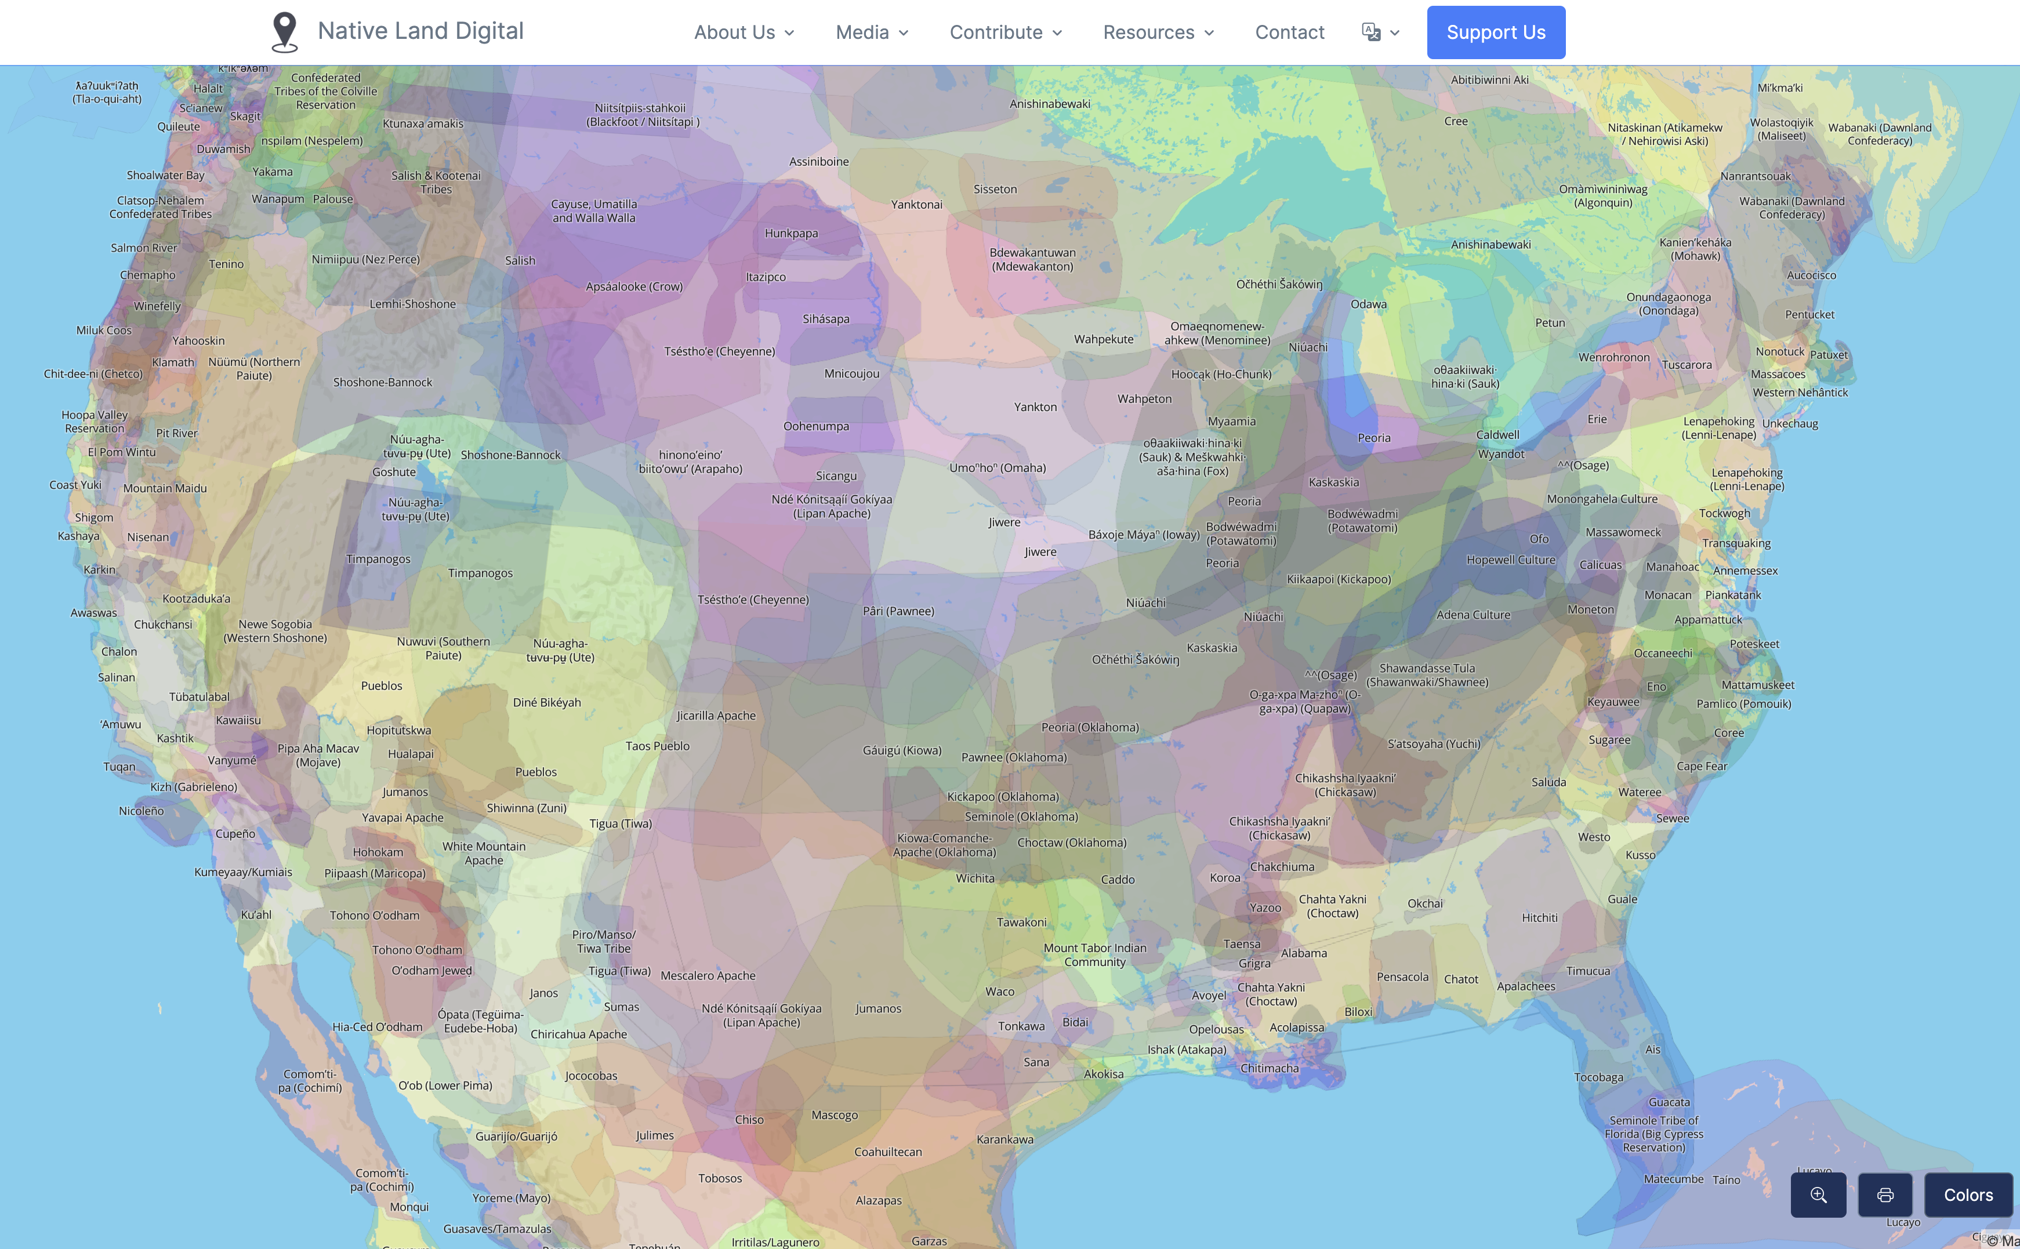
Creating Federal Public Lands in the United States
Eastern states with no remaining federal public lands to sell were granted “land scrip” for acquired federal public lands in western states and territories
More than 10 million of the 17 million acres set aside by the Morrill Act were expropriated lands from indigenous populations
Learn more: https://native-land.ca/

Slide 20
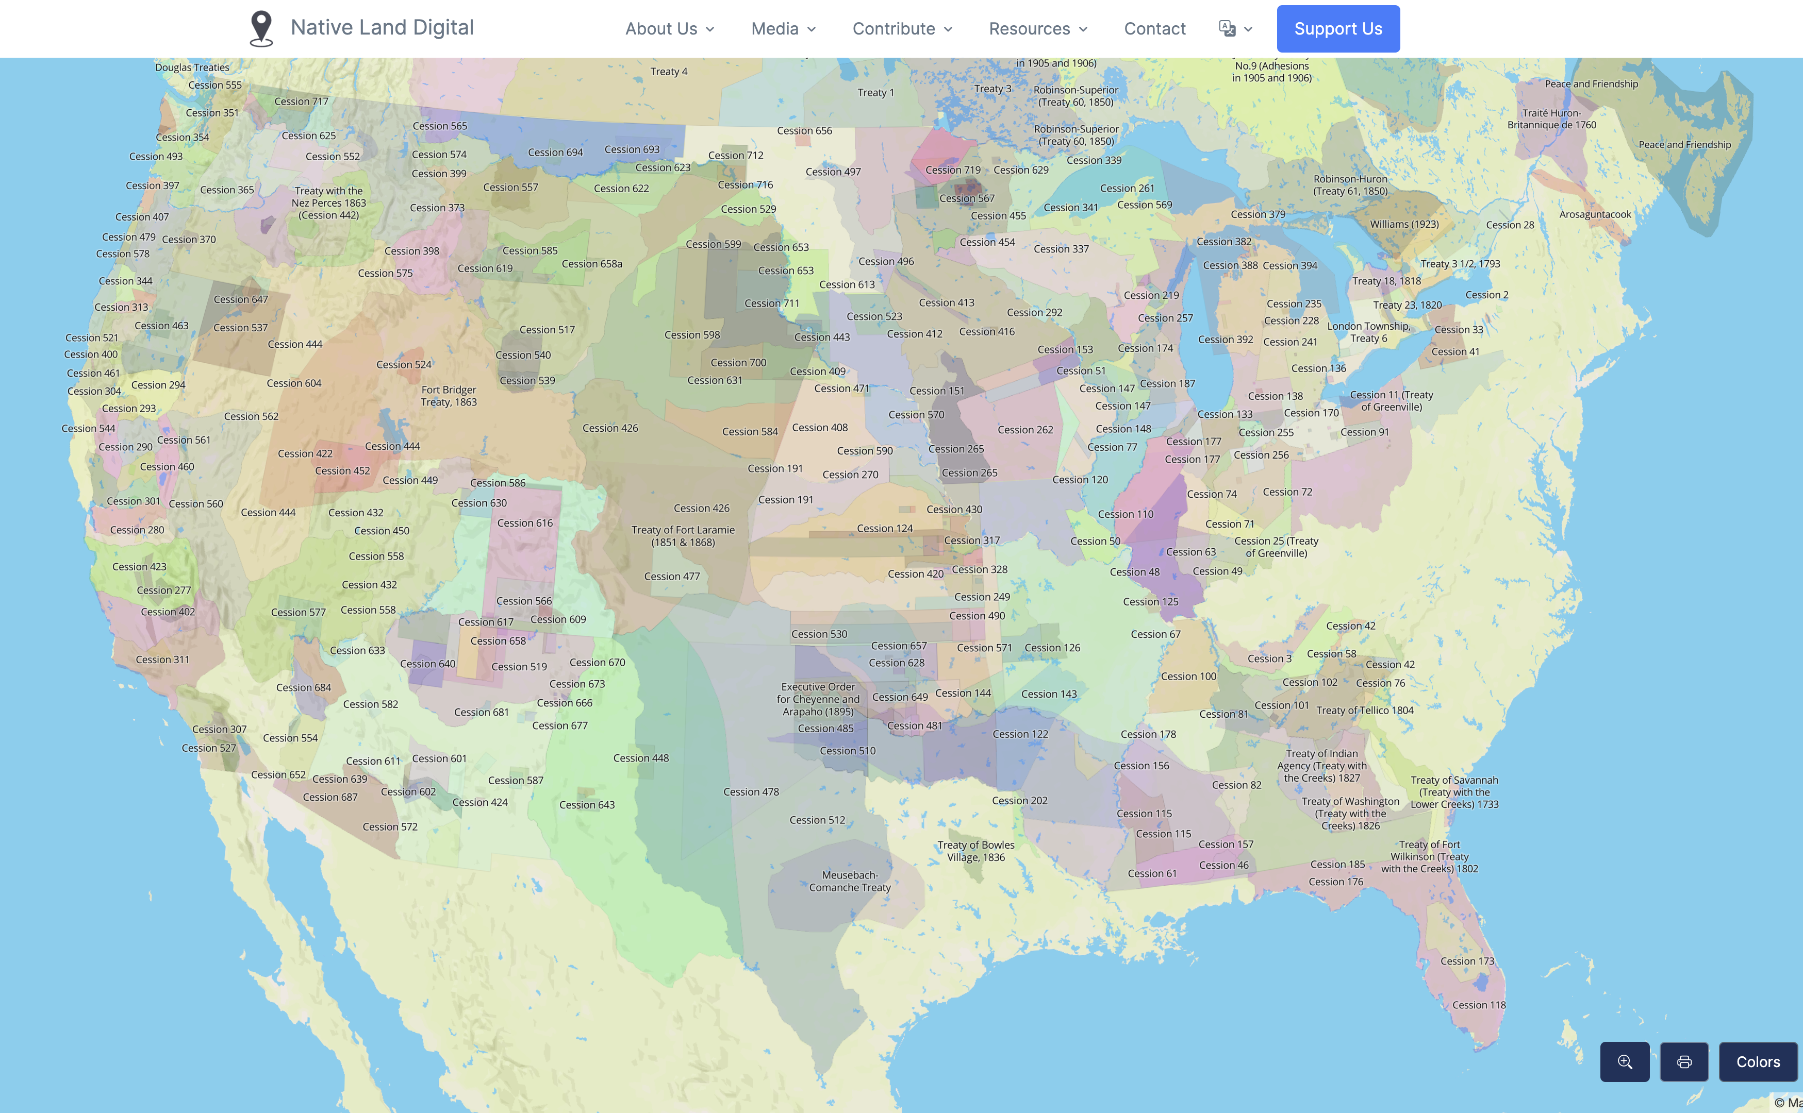
Creating Federal Public Lands in the United States
Of the total 780,000 acres granted to Pennsylvania, 27,200 acres were previous lands occupied by Great and Little Osage, Kickapoo, Lenape, Shaawanwaki, Sa'wano'ki, and Shaawanowi lenaweeki people in today’s Missouri
One scholar has traced the sale of these lands back through treaties between 1808 -1829
Learn more: Nash, M. (2019). Entangled Pasts: Land-Grant Colleges and American Indian Dispossession. History of Education Quarterly, 59(4), 437-467. doi:10.1017/heq.2019.31

Slide 21
Land Acknowledgement
The Pennsylvania State University campuses are located on the original homelands of the Erie, Haudenosaunee (Seneca, Cayuga, Onondaga, Oneida, Mohawk, and Tuscarora), Lenape (Delaware Nation, Delaware Tribe, Stockbridge-Munsee), Monongahela, Shawnee (Absentee, Eastern, and Oklahoma), Susquehannock, and Wahzhazhe (Osage) Nations. As a land grant institution, we acknowledge and honor the traditional caretakers of these lands and strive to understand and model their responsible stewardship. We also acknowledge the longer history of these lands and our place in that history.

Slide 22
Expanding the Land-Grant System
The second Morrill Act of 1890 required states to establish separate land-grant institutions for Black students or demonstrate that admission to the state’s existing land-grant was not restricted by race.
The Equity in Educational Land-Grant Status Act of 1994 added institutions that were founded and chartered by American indigenous tribes and predominantly enroll Native students.
For both the 1890 and 1994 institutions, rather than initially granting land scrip the federal government appropriated funds to support research, education, and extension at these institutions.

Slide 23
Agricultural Experiment Stations
Land Scrip
Land-Grant
USDA NIFA
Capacity Grants
Hatch
Animal Health
Smith-Lever
McIntire-Stennis

Slide 24
Federal Capacity Grants and
Pennsylvania Agricultural Land Scrip Funds

Slide 25
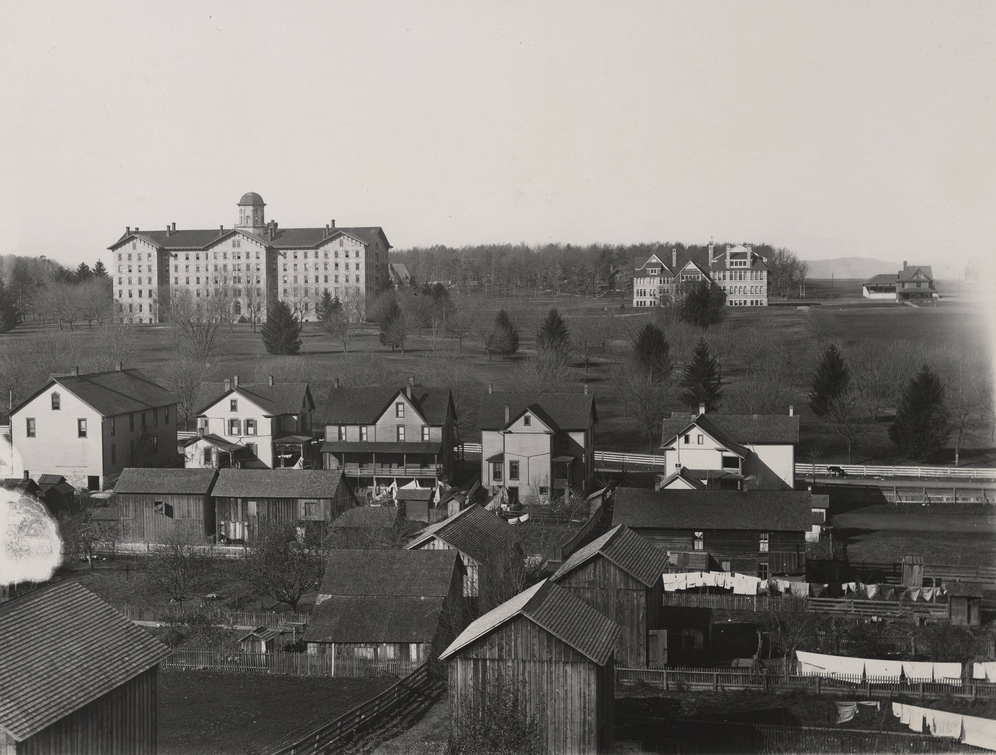
Pennsylvania Agricultural Land Scrip Fund
1867
Pennsylvania completes the sale of all land scrip granted by the Morrill Act, with sales totaling $439,186.80 (average of 56.3 cents per acre – only about $12 in today’s dollars)
State legislature designates the Agricultural College of Pennsylvania as the sole beneficiary of the Morrill Act
1872
State legislature authorizes the sale of the bonds to issue a single bond for $500,000 at 6% payable in fifty years, making up the difference out of its general revenues
1923
The 1872 bond is redeemed and a new issue for the same amount is sold with the state obligating itself to guarantee principal and 5% rate of interest for the endowment (as specified in the Morrill Act)
This was designated as the “Agricultural Land Scrip Fund,” set aside as a “restricted” account “for the purpose of funding agricultural research programs and agricultural extension services”
1929
State legislature establishes the current “Fiscal Code,” which builds on the 1863 and 1923 legislation, denoting the “Agricultural Land Scrip Fund” as a restricted account; at this time, includes all funds appropriated to the university as the land-grant institution
Old Main (1857-63), shown in 1890-1899 (Penn State University Libraries Special Collections Online)
2011
“Agricultural College Land Scrip Fund” is identified as a separate line in the state’s direct appropriations to Penn State, specifically for agricultural research and extension activities

Slide 26
Agricultural Experiment Stations
Land Scrip
Land-Grant
USDA NIFA
Capacity Grants
Hatch
Animal Health
Smith-Lever
McIntire-Stennis

Slide 27
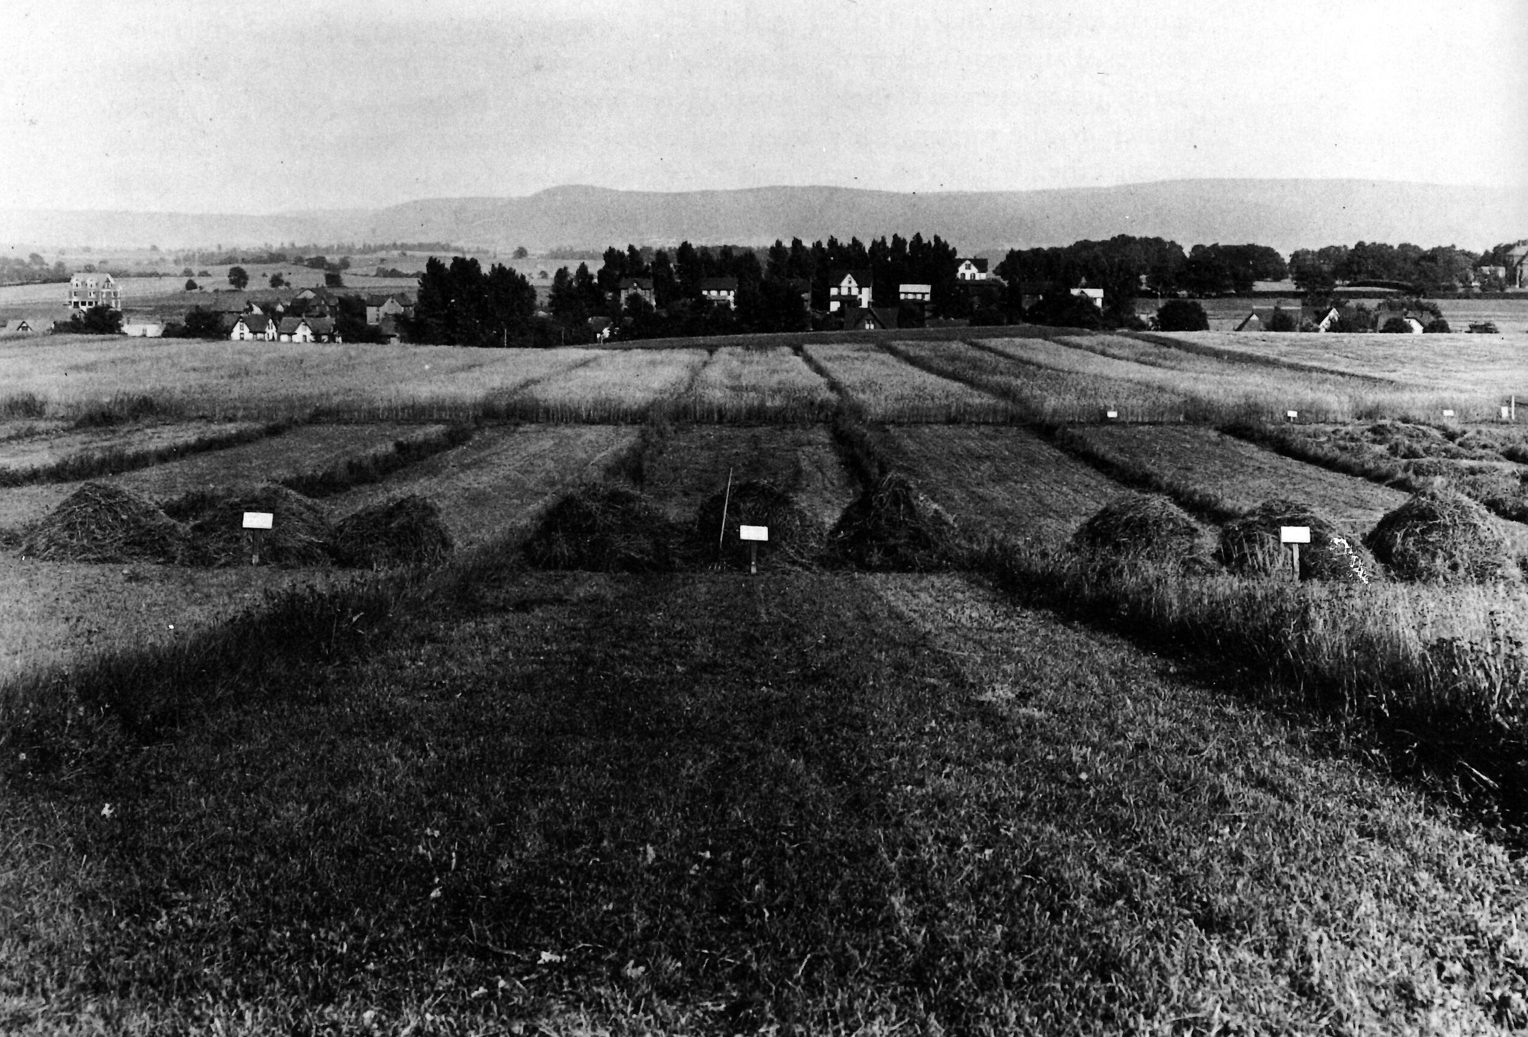
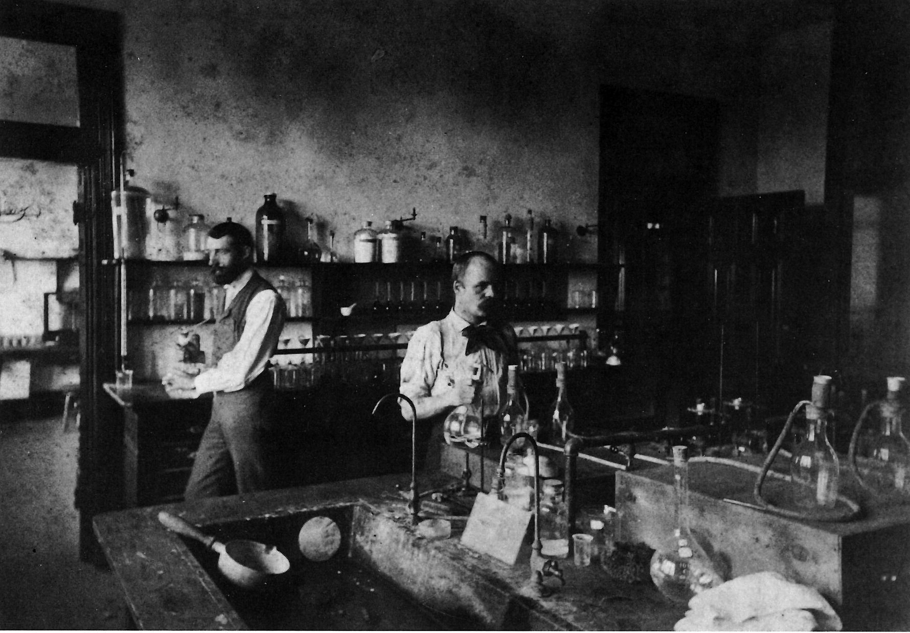
Establishing funding for agricultural research
Jordan Fertility Plots (1909). Bezilla, The College of Agriculture.
Evan Pugh had pushed for a national network of agricultural experiment stations as early as the 1860s, but nothing came to fruition for a couple of decades after the passage of the Morrill Act
At the Agricultural College of Pennsylvania, scientists on the faculty were pushing to conduct scientific experiments, using the land immediately adjacent to the campus to run soil tests and crop trials with various fertilizers
Other agricultural colleges were establishing agricultural experiment stations through state support, such as in New York, New Jersey, and Connecticut
George Atherton carried forward the vision for a national network of research stations and was a key player in advocating for the legislation that would provide federal funding to support agricultural research
Debate over the use of the funding to support teaching or research played out over the next decades
Inside the Agricultural Experiment Station (1890). Bezilla, The College of Agriculture.

Slide 28
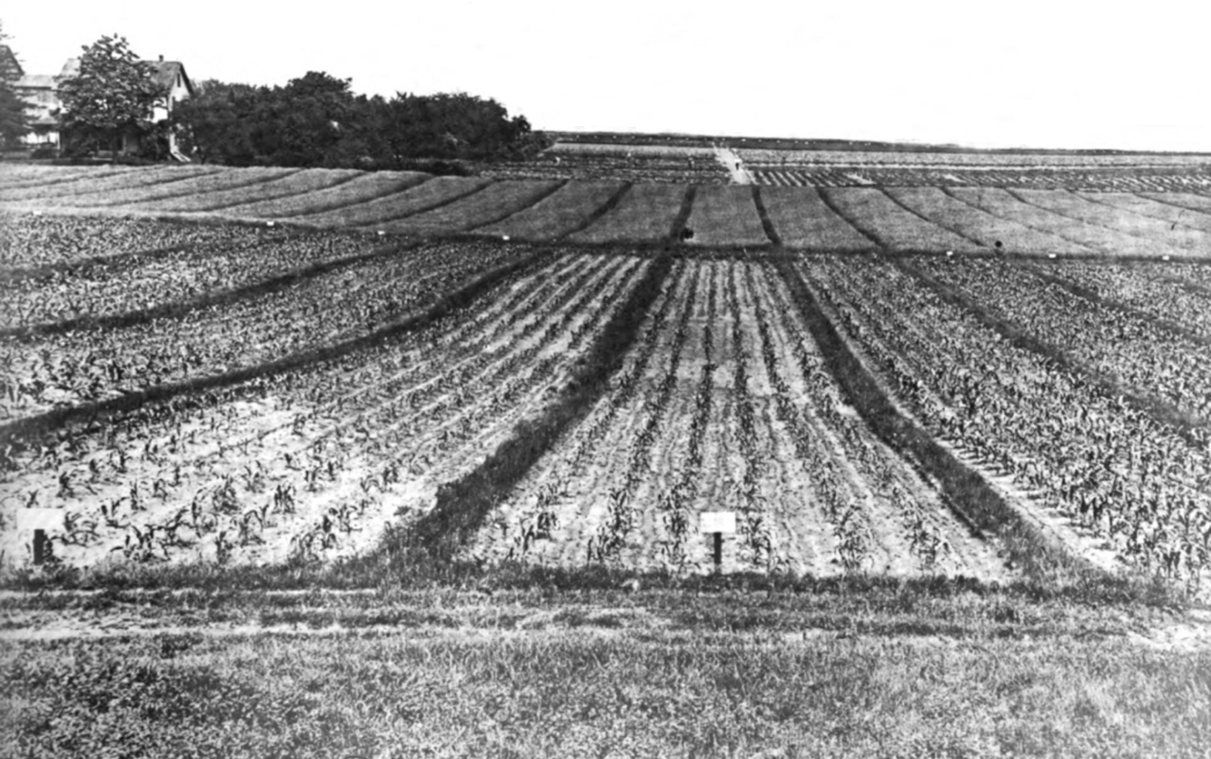
Beginnings of the Agricultural Experiment Station
1867
Pennsylvania legislature diverts $43,886.50 was diverted from the perpetual endowment fund created by the sale of the federal land scrip for the purchase of three “Model and Experimental Farms” (purchased in Chester and Indiana counties and adjacent to the college campus)
On the campus farm, students and faculty conducted experiments in growing grains, grasses, and potatoes under various soil conditions
Historical marker outside Tyson Building
1874
The Agricultural College is renamed the Pennsylvania State College
1881
Whitman H. Jordan, an agricultural chemist, joined the faculty and initiated a series of experiments with fertilizers, laying out 144 soil plots of one-eighth acre each and documenting the crops and fertilizers used (now known as the Jordan Soil Plots)
Jordan issued bulletins reporting on the results, advocating for a more widespread distribution of the bulletins and for the establishment of an agricultural experiment station like those in NY and NJ
1885
1887
The Hatch Act was signed into law on March 2, establishing a national network of agricultural experiment stations at land-grant institutions; George Atherton (president of the college at the time) played a key role in this legislation
Pennsylvania legislature agreed to the sale of the eastern and western experimental farms and appropriated an additional $12,000 to go toward building the Pennsylvania Agricultural Experiment Station
Jordan Soil Plots. Bezilla, The College of Agriculture.

Slide 29
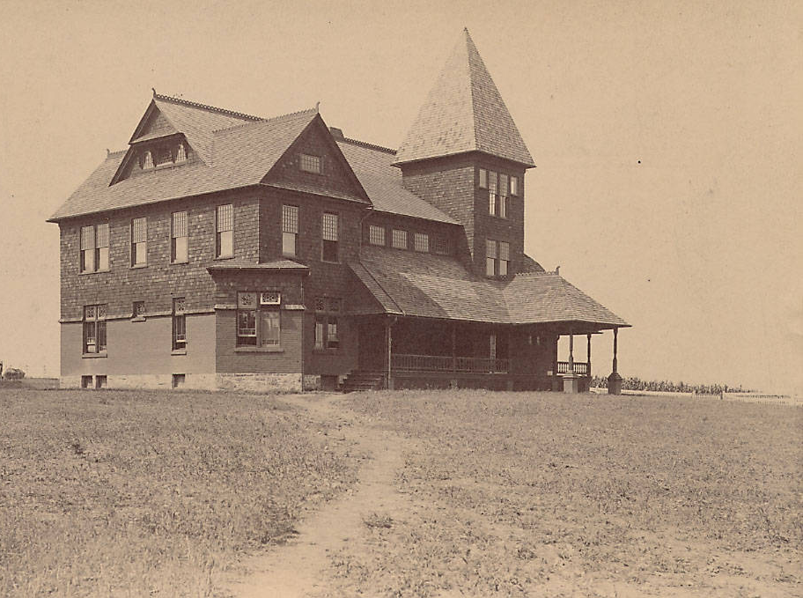
Hatch Act of 1887
“An act to establish agricultural experiment stations in connection with the colleges established in the several States under the provisions of an act approved July second, eighteen hundred and sixty-two, and of the acts supplementary thereto.”
Historical marker outside the Arts Cottage
“…it shall be the object and duty of said experiment stations to conduct original researches or verify experiments… bearing directly on the agricultural industry of the United States as may in each case be deemed advisable, having due regard to the varying conditions and needs of the respective States or Territories.”
$15,000 appropriated to each state annually (that is approx. $475,000 in today’s dollars)
Office of Experiment Stations (OES) established in 1888 for the exchange of information between stations
First disbursement of appropriations to Pennsylvania in 1888
New building opened in 1889
Congress delegated the oversight of Hatch funds to the OES in 1894, which began review visits to the stations in 1895
Required states to match the appropriations 1:1
Pennsylvania Agricultural Experiment Station (built 1887-89), shown here soon after completion. (Penn State University Libraries Special Collections Online)

Slide 30
Agricultural Experiment Stations
Land Scrip
Land-Grant
USDA NIFA
Capacity Grants
Hatch
Animal Health
Smith-Lever
McIntire-Stennis

Slide 31
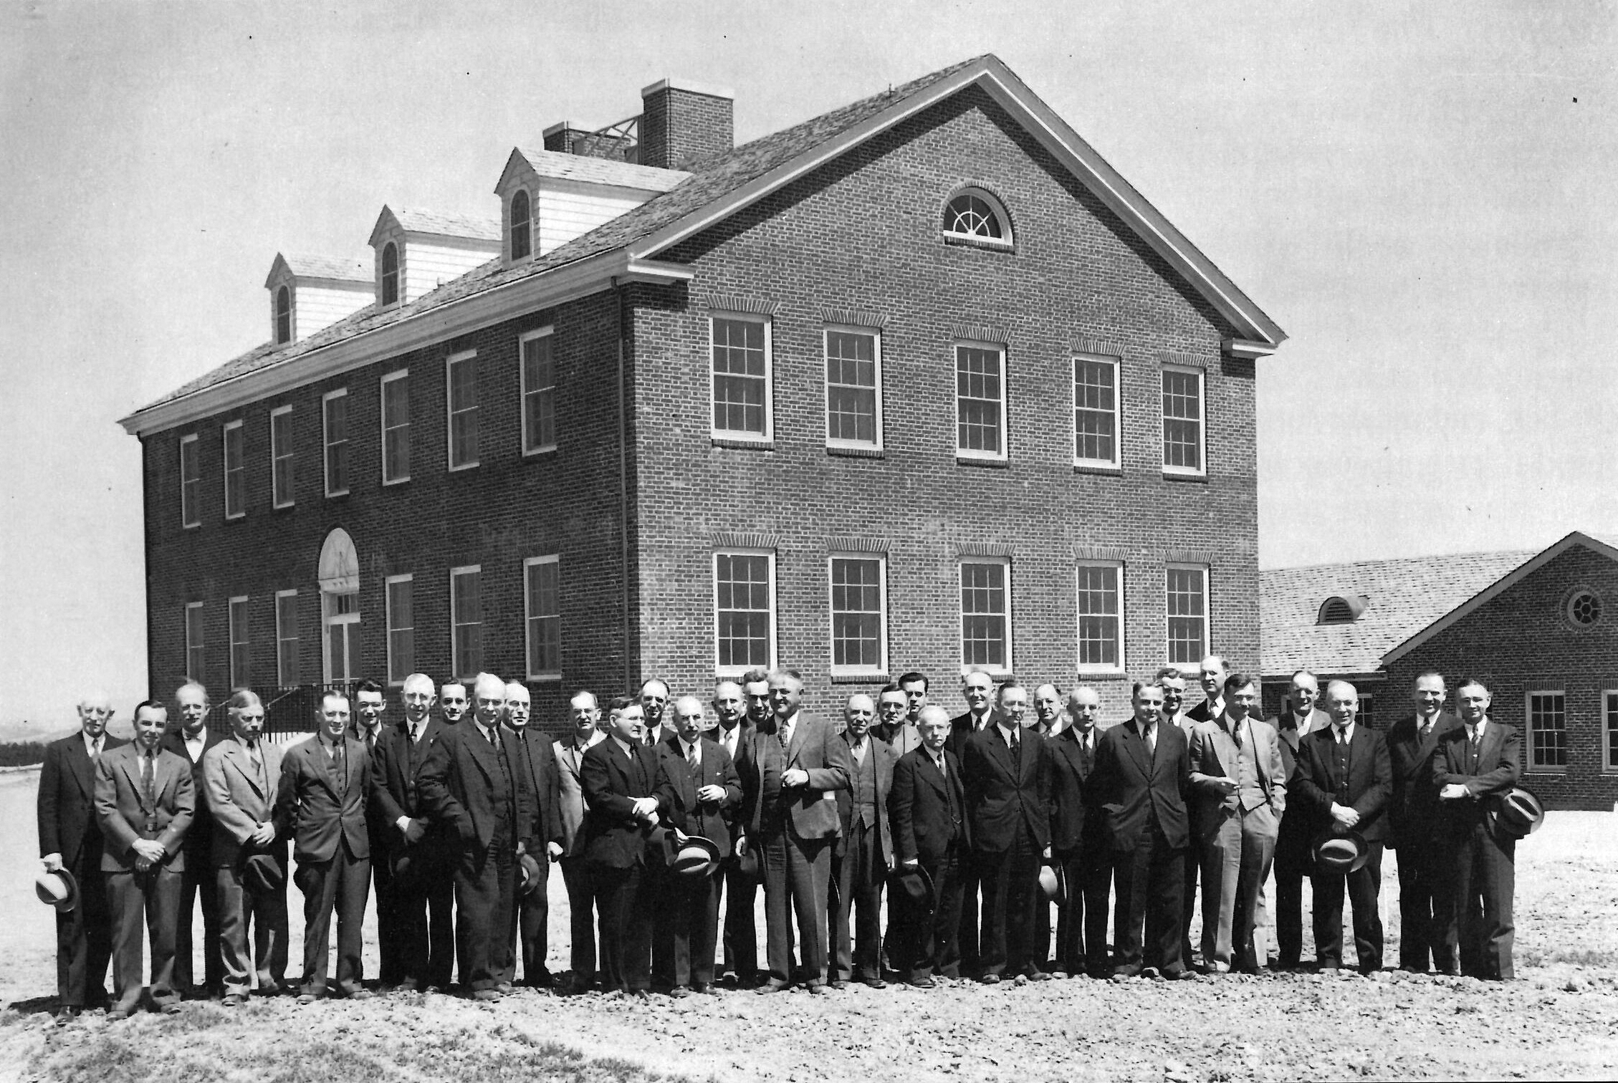
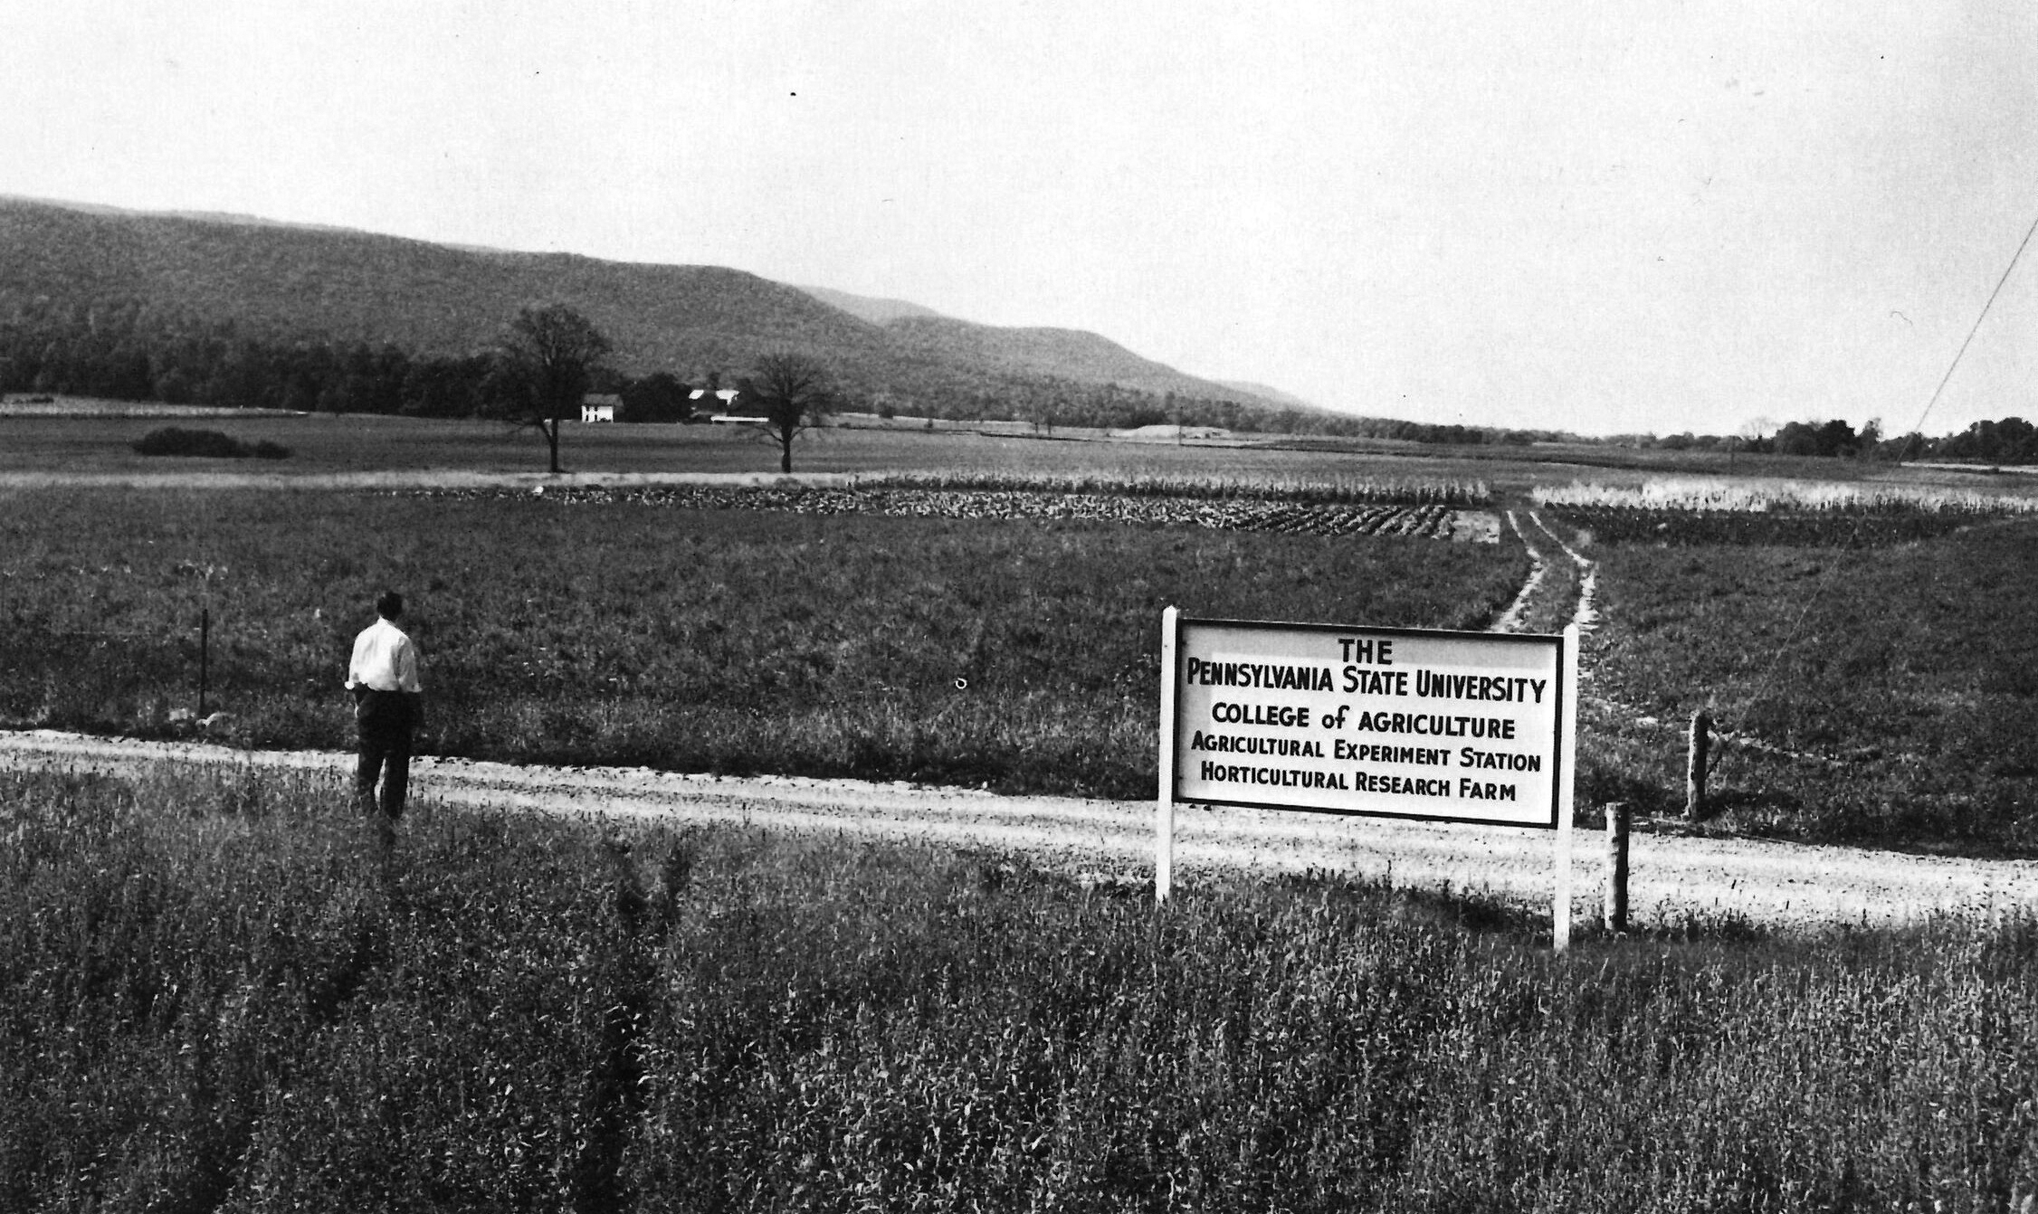
A national system for advancing agriculture
Opening of the new USDA ARS building on campus (1937). Bezilla, The College of Agriculture.
Over the decades following the Hatch Act, a number of new bills were signed into law that
Increased funding levels
Outlined a system for tracking and coordinating the research across the national network
Expanded the scope of research needs
Codified extension as an integral component of the land-grant system
The need for coordinated efforts drove many of the conversations, addressing the perpetual tensions between research efforts and practical applications
The early 20th century brought a host of challenges that impacted the lives of Americans:
The Great War (World War I) from 1914-18 (US involvement from 1917-18)
The Great Depression, which was initiated by the stock market crash in 1929 and continued to impact lives through the next decade and more
Russell Larson at the newly purchased experimental farms at Rock Springs (1960). Bezilla, The College of Agriculture.

Slide 32
Growing Agricultural Research
1906
Adams Act
Passage of the Smith-Lever Act which provided federal funding to support a national system for rural adult vocational education with admins in land-grant colleges and county agents
Doubled the appropriations to the stations and restricted the funds to “only paying the necessary expenses of conducting original researches and experiments”
Assigned to the OES the duty of annual certification of eligibility of the stations
Prompted the creation of the project system
Required each station to submit for approval a written plan of work, with all activities grouped into “projects”
1914
1925
Purnell Act
Provided additional appropriations, stepping up to $60,000 ($1.08M today) per station by 1930
Added language applicable to the Hatch funding for the “development and improvement of the rural home and rural life,” following from national movements to incorporate economic and sociological studies into the experiment station research
Congress passes the first Farm Bill as a part of the New Deal legislation.
1933
The USDA establishes the U.S. Regional Pasture Research Laboratory (2nd of the 9 labs established in the US under the Bankhead-Jones Act), purchasing land and erecting a new building adjacent to the Agricultural College campus.
1935
Bankhead-Jones Act
Called for an additional $1 million for the entire Hatch program the following year and annual increases until the total reached $5 million by 1940
60% of the funds would be appropriated to the state stations, distributed based on each state’s proportion of the rural population (the beginning of formula funds)
Required states to match the appropriations from their treasuries
The remaining 40% was used at the discretion of the Secretary of Agriculture, and one half of this was to be used to establish and maintain research laboratories in major agricultural regions (many created near land-grant colleges)
1937

Slide 33
Refining Agricultural Research Administration
During this period, the College of Agriculture leased and purchased properties in Erie, Adams, and Lancaster counties for the establishment of field stations, now known as the Research and Extension Centers.
1946
Research and Marketing Act
Increased appropriations for expanded capacity and included titles allocation money specifically for marketing research
Dedicated one quarter of the total appropriation for a “Regional Research Fund” to support cooperative investigations across states and of regional importance
Established a Committee representing four regions to review proposals and centrally administer the funds for joint projects
Changed the formula for the allocation of the appropriations going to states to also include a base allocation evenly split among all stations (20%) and an additional sum on a formula based on a state’s rural and farm populations (52%)
Under the new Eisenhower administration, the Office of Experiment Stations is reorganized under the newly formed Agricultural Research Service as the State Experiment Stations Division
1953
1955
Hatch Act (consolidated)
Pennsylvania’s land-grant institution is elevated to university status as the Pennsylvania State University
A ten-year effort to consolidate the Adams, Purnell, Bankhead-Jones, and the Research and Marketing acts under the Hatch Act is signed into law in August
A year later the regional research Committee named a subcommittee to review the regional proposals
Under the new Kennedy administration, the State Experiment Stations Division becomes the Cooperative State Experiment Station Service (CSESS). It was renamed again the following year to the Cooperative State Research Service (CSRS)
1961
1962
McIntire-Stennis Act
Intended to encourage forestry research a land-grant colleges, experiment stations, and other qualified forestry schools by allocating funds based on a formula that primarily accounted for acreage of non-federal commercial forest land and the volume of timber annually cut in each state; these funds were dispersed for the first time in 1964 under the CSRS

Slide 34
Research Capacity Grant Programs
allocated to the Pennsylvania Agricultural Experiment Station through USDA National Institute for Food and Agriculture
$8,063,943
90%
$794,764
$1,811,996
$56,793
9%
1%
Hatch
Hatch
Multistate
McIntire-Stennis
Animal Health and Disease Research
single or multi-investigator projects
cover a broad spectrum of agricultural research addressing challenges at the local, state, regional and national levels
majority of faculty in the college participate in a Hatch project
multidisciplinary projects that coordinate research concerning more than one state or a region
require jointly planned, cooperative efforts that integrate activity of the participants, include multidisciplinary approaches, and are mutually beneficial to the states involved
competitively awarded
address a wide range of forest research topics pertaining to management, protection, and utilization of state forests
competitively awarded
address a number of animal health concerns, including the general welfare and productivity of income-producing animals, as well as disease prevention for both animals and humans
Learn more: https://agsci.psu.edu/inside/knowledgebase/research-support/aes-resources/capacity-grants

Slide 35
Agricultural Experiment Stations
Land Scrip
Land-Grant
USDA NIFA
Capacity Grants
Hatch
Animal Health
Smith-Lever
McIntire-Stennis

Slide 36
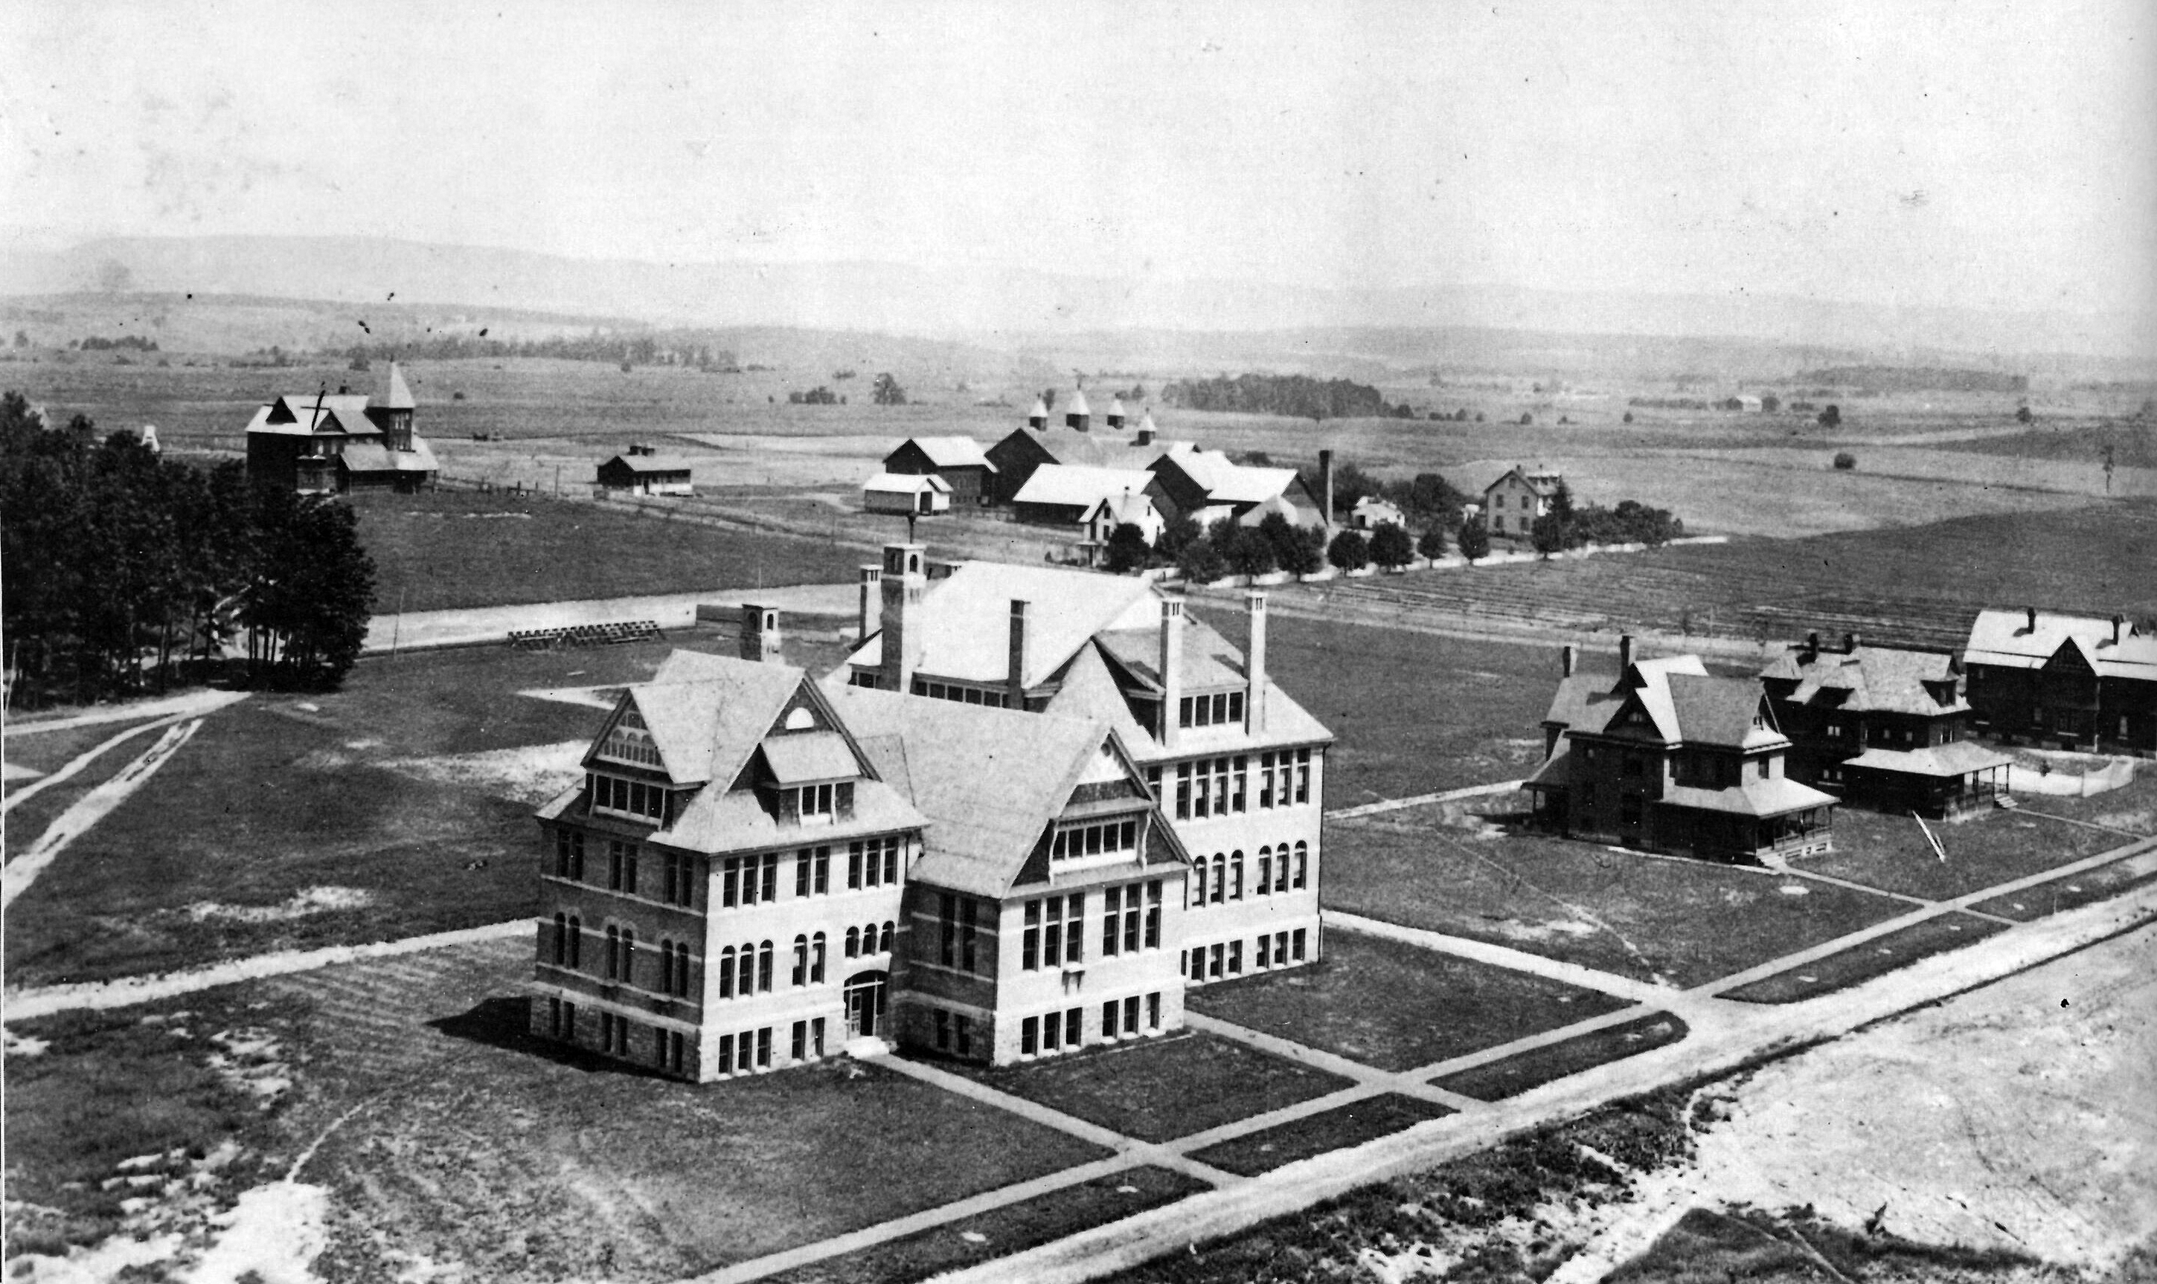
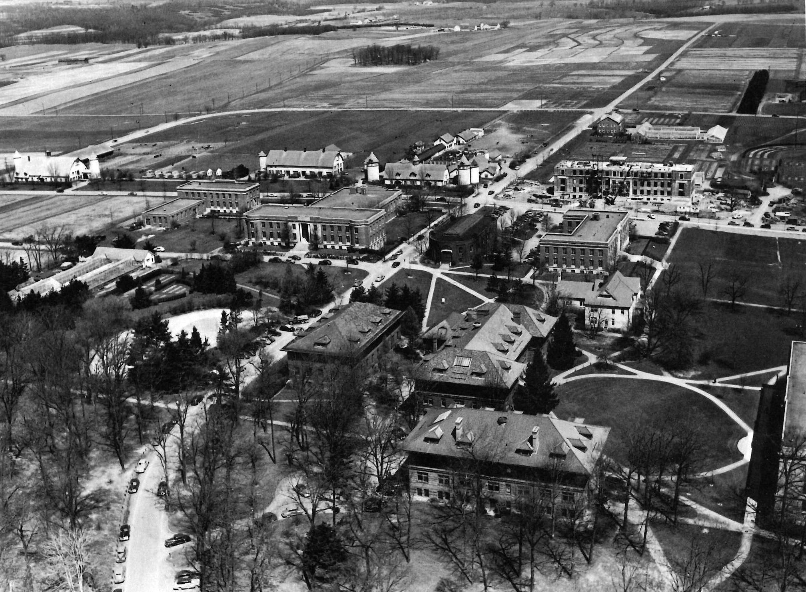
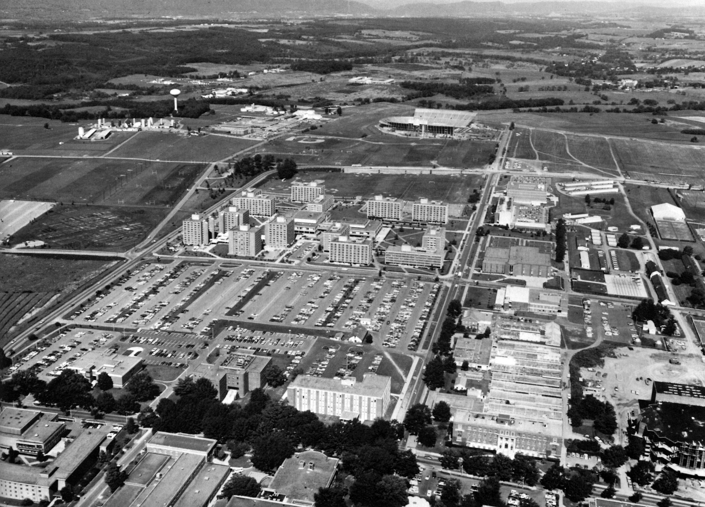
Prioritizing capacity building and coordination
Ag Hill from Old Main (early 1900s). Bezilla, The College of Agriculture.
Tensions around the application of the research to the benefit of producers grew in the 1960s and 1970s, influencing much of the legislation around agriculture in the latter half of the 20th century
Based in concern around the focus of research to increase productivity and the consequent environmental impacts of that as well as the growing consolidation of agribusiness
Efforts by the experiment station directors to reframe the impact and value of agricultural research and the need for continued public investment
Growing efforts to plan, review, and report on the projects supported by the Agricultural Experiment Station funding
Positioning the network of research as necessary capacity to respond to evolving and continuing threats to food security, economic prosperity, and the environment
See as a legislative response to the pushback an expansion of funding for competitive grants
Ag Hill aerial view (1949). Bezilla, The College of Agriculture.
Ag Hill aerial view (1972). Bezilla, The College of Agriculture.

Slide 37
Defining the Current Agency
1965
Hatch Act (amended)
The amended act authorized “Specific Research Grants” (later called “Special Grants”), which were awarded annually for 5-year proposals in areas singled out by Congress and selected by a review committee formed under CSRS
The college purchases more than 1,500 acres southwest of campus at Rock Springs.
1972
1977
National Agricultural Research, Extension, and Teaching Act
Experiment Stations are asked to develop in-station peer review processes of each project proposal to accompany submission to CSRS for final approval.
Title XIV under the larger Food and Agriculture Act of 1977 (the Farm Bill), which designated the USDA as the “lead agency…for food and agricultural sciences”
Authorized specific funding to award research grants on a competitive basis
Laid out the requirements for a plan of work that must be submitted before disbursements for that fiscal year would be made
Program established for appropriations to support animal health and disease research
1994
Department of Agriculture Reorganization Act
Merged the former Cooperative State Research Service and the former Extension Service into a single agency — the Cooperative State Research, Education, and Extension Service (CSREES)
1998
Agricultural Research, Extension, and Education Reform Act
Amended the name of the “Regional Research Fund,” established as 25% of Hatch allocations under the Research and Marketing Act of 1946, to the “Multistate Research Fund”
2008
Food Conservation and Energy Act
Under the 2008 Farm Bill, the CSREES was renamed as the National Institute for Food and Agriculture (NIFA)

Slide 38
AES Administration and Obligations
administered by AES staff in the Office for Research and Graduate Education and individual departments
Annual Report of Accomplishments and Combined Research and Extension Plan of Work (POW)
Beginning of Federal Fiscal Year
Financial Reports
Research Results and Extension Results
End of
Federal Fiscal Year
October
January
February
March
April
September
Learn more: https://www.nifa.usda.gov/data/nifa-reporting-system

Slide 39
Funding Landscape for Agricultural Research Today
Authorization and Appropriations
Congress authorizes funding lines in the Farm Bill every 5 (or so) years
In February/March of every year the President releases the Presidential Budget Request (PBR)
Congress begins appropriations process in spring/summer of each year with the intention to pass the omnibus appropriations bill to allocate funding on the authorized lines by September (often not passed on time)
Competitive and Capacity Grants
Both capacity and competitive grants for agricultural research must be authorized and appropriated for administration under the USDA
APLU lobbies on behalf of land-grant institutions for the continuation and expansion of these programs
Competitive grants are those administered by USDA NIFA under the AFRI appropriation or other specific lines (e.g., SCRI, OREI, etc.)
Every 5 years
Farm Bill authorizes funding lines for five years (typically)
PBR lays out priorities of the administration for appropriations funding each year
Congress debates and passes the omnibus appropriations bill each year
Funding is appropriated for capacity funds (based on statutory formula) & competitive lines
Appropriations process repeated each year (four years)
Every year

Slide 40
The Pennsylvania Agricultural Experiment Station
Responsibility and Obligation
Historical Context
Projects
Reporting
Funding
Capacity
How we came to be…
What we are collectively contributing…

