Slide 1
Overview of Enhancing Food Security in the Northeast through Regional Food Systems
December 10, 2015
USDA Grant # 2011-68004-30057 and USDA Grant # 2014-68004-22166

Slide 2
Two Versions of Food Security
Food security of a nation or region of the country producing enough food to feed itself in the event of crop failure or import shortfalls (FAO 1981), measured by food self-sufficiency ratio.
Food security of a community: “a condition in which all community residents obtain a safe, culturally acceptable, nutritionally adequate diet through a sustainable food system that maximizes community self-reliance and social justice.” (Hamm & Bellows 2003)

Slide 3
Why Approach Through Both Lenses?
The primary outcome of every generic food system is food security (Ericksen 2007).
Low-income populations don’t exist in a vacuum.
Need to address significant differences while moving to more inclusive picture.

Slide 4
Why Engage Food Security at the Regional Level?
1. “It is at the regional level that many earth system changes are significant – altering flows of water, trade, disease, and human migration.” (Ericksen 2007)
2. Regional is an “appropriate scale for addressing rural development, urban regeneration, agricultural food strategies, and producer and consumer reconnection.” (Kneafsey 2010)

Slide 5
Northeast Regional Entities
NE Regional Center for Rural Development
NE Sustainable Agriculture Working Group
NE MyPlate

Slide 6
Assumptions about Regional Approach
Offers a more ecological focus on population density, environmental conditions, and marketing infrastructure.
The concept of region is different according to context. Boundaries are fluid and nested.
Regions evolve.
Some concepts apply to localization.

Slide 7
Four dimensions of regional
Food supply
Natural resource sustainability
Economic development
Diversity (Ruhf and Clancy 2010)

Slide 8
“The transformative approach to improving agricultural sustainability…would facilitate the adoption of production approaches that capitalize on synergies, efficiencies, and resilience characteristics associated with complex natural systems and their linked social, economic, and biophysical systems.”
Source: Toward Sustainable Agricultural Systems in the 21st Century. National Research Council, 2010.

Slide 9
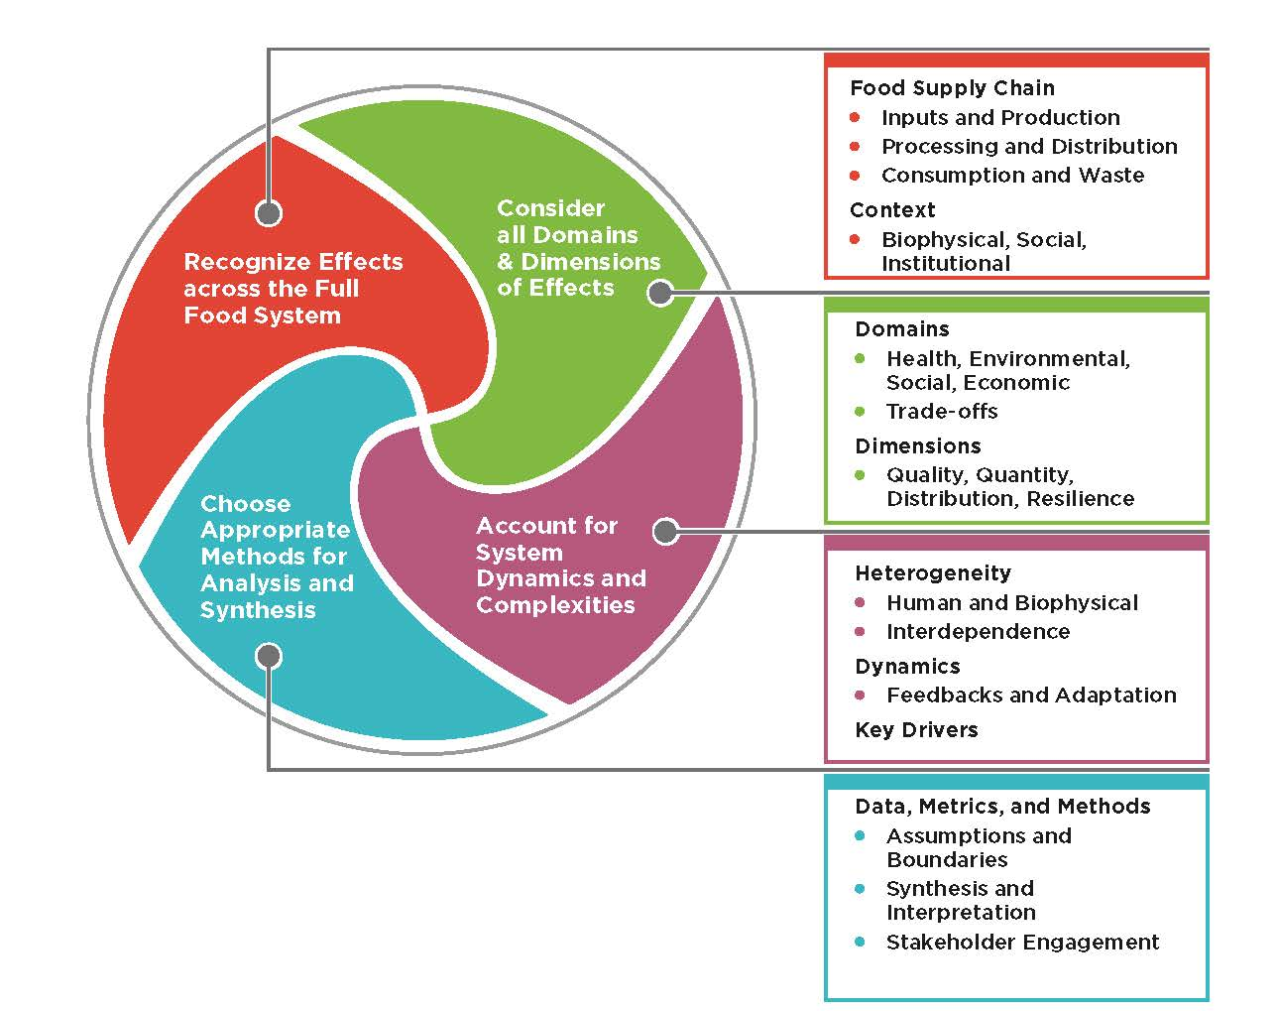
Framework Concept
Source: A Framework for Assessing The Effects of the Food System. IOM and NRC. 2015.

Slide 10
Analyzing Food Security in Context of Drivers and Feedbacks
GEC Drivers
Changes in:
Land cover and soils
Atmospheric composition
Climate variability and means
Water availability and quality
Nutrient availability and cycling
Biodiversity
Sea currents and salinity
Sea level
Environmental Feedbacks
(water quality, greenhouse gases)
Food System Activities
Producing
Processing and packaging
Distributing and retailing
Consuming
Natural Drivers
(volcanoes, solar cycles)
Food System Outcomes
Contributing to Food Security,
Environmental Security, and Other
Societal Interests:
Food utilization
Food availability
Social welfare
Food access
Environmental capital
Drivers’
Interactions
↑
Socioeconomic Drivers
Changes in:
Demographics
Economics
Socio-political context
Cultural context
Science and technology
Socioeconomic Feedbacks
(livelihoods, social cohesion)
Source: Ericksen, P. GECAFS. 2009.

Slide 11
Complex Adaptive Systems
Composed of many heterogeneous pieces whose interactions drive system behavior in ways that cannot be easily understood from considering components separately
Properties:
Individuality and adaptation
Feedback and interdependence
Heterogeneity
Spatial complexity
Source: A Framework for Assessing The Effects of the Food System. IOM and NRC. 2015.

Slide 12
Applications to Food Security
Food insecurity is the result of multiple forces
Systemic approaches to food access may be more cost-effective, reach larger numbers of people, and be easier to sustain than individual approaches.

Slide 13
Orienting Goal
To assess whether greater reliance on regionally produced foods can improve food access for low-income communities, while also benefiting farmers, food supply chain firms, and others in the food system.

Slide 14
Framing Questions
What is the Northeast food system? Using a consistent set of metrics, define the salient attributes that describe Northeast consumers and the system of farms, processors, and distributors that supply the region’s food.
Is food sufficiently accessible and affordable for Northeast consumers? Work in the target sites will help to determine if food is not sufficiently accessible and affordable to consumers in locations where it is already available.
How might the Northeast food system respond to future challenges and opportunities? Numerous drivers of food demand and shocks to food production will influence the relative importance of regional food systems. Scenarios of alternative futures will be analyzed using economic and bio- physical models to address increasing demand for regional products, changes in land availability, the influence of fuel price shocks, and climate change.
What changes would be required in key elements of the Northeast food system to provide more regionally produced and processed food in low income sites in the Northeast? Changes may be necessary in multiple elements of the food system, such as production, infrastructure, demand, and policy.
Notes:
I edited existing text for space. Includes cutting of following sentences:
Distinguish how the food system of low-income populations differs from that of the region as a whole.
None
The response of these alternative food systems will be evaluated in light of the attributes defined in question one.

Slide 15
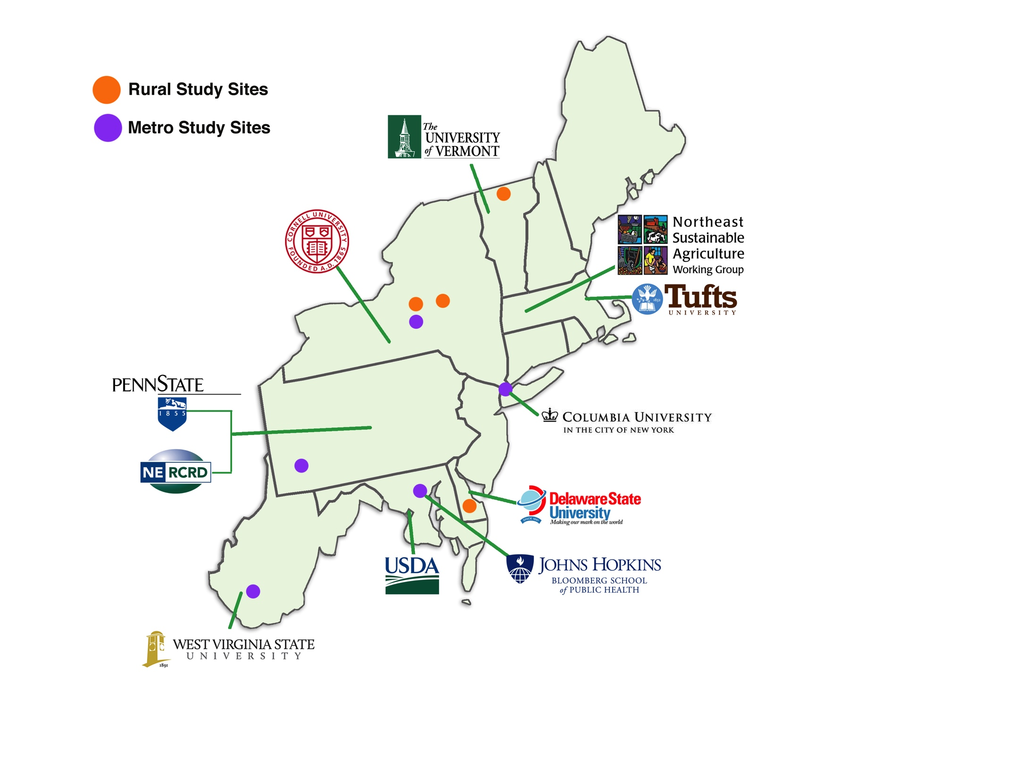

Slide 16
Integrative Approach: 11 Institutions
Agricultural Research Service/USDA – Orono, ME and Beltsville, MD
Columbia University, Urban Design Lab
Cornell University and Syracuse Cooperative Extension
Delaware State University
Economic Research Service/USDA Washington, DC
Johns Hopkins University Bloomberg School of Public Health, Center for a Livable Future
Northeast Regional Center for Rural Development (PD)
Northeast Sustainable Agriculture Working Group
Tufts University, Friedman School of Nutrition
Penn State University
University of Vermont
West Virginia State University

Slide 17
Integrative Approach: Multiple Disciplines
Agricultural Engineering
Agricultural Economics / Economics
Agronomy
Architecture / Urban Design
Civil Engineering
Climatology
Communications
Community Development
Crop and Soil Science
Education
Food Policy
Food Systems
Public Health
Natural Resource Management
Nutrition Science
Sociology

Slide 18
Organizational Chart
Advisory Board: Robert King, Toni Liquori, David Marvel, Joyce Smith
Stephan J. Goetz
Project Director
Kate Clancy
Deputy Director
Obj. 1: Consumption
Anne Palmer
Linda Berlin
A. Bonanno
Anita Bono
Kate Clancy
Rebecca Cleary
Kathy Dischner
Bonnie Dunn
Carol Giesecke
Clare Hinrichs
Heather Mikulas
Obj. 2: Distribution
Miguel Gomez
Patrick Canning
Kate Clancy
Oliver Gao
Frank Ge
Elaine Hill
Kris Park
Obj. 3: Production
T. Griffin/C. Peters
Michael Conard
David Fleisher
Obj. 4: Outreach
Kathryn Ruhf
Linda Berlin
Michael Conard
Kristen Devlin
Deno DeCiantis
Scenarios & Modeling
C. Peters
Obj. 5: Education
C. Peters
Linda Berlin
Carol Giesecke
Tim Griffin
Clare Hinrichs
Alessandro Bonanno
Patrick Canning
Kate Clancy
Michael Conard
Dave Fleisher
Frank Ge
Miguel Gomez

Slide 19
Study Design
Location
One of nine locations (e.g., Baltimore)
One or two neighborhoods or communities per (low-income) location; focus groups
One or two stores per location; consumers patronizing the stores; market basket (MB)
Supply chains, business owners
Local
Regional
Agricultural production capacity, 300 NE counties
National
International

Slide 20
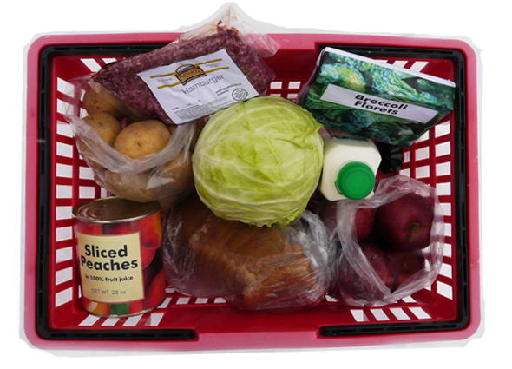
Market Basket
milk
bread
ground beef
potatoes
apples
cabbage
Canned peaches
Frozen broccoli

Slide 22
Research Teams
Consumption (CONS) – Community members, stores, food access
Distribution (DIST) – Store case studies, MB optimization models, hub models
Production (PROD) – Regional self-reliance, foodprints, climate change, land use
Scenarios and models (SCEMO) – Integration, metrics, cross-project writing

Slide 23
Other Teams
Education (EDUC) – Research training, courses, internships
Outreach (OUTR) – Communications, meetings, presentations, Modeling Learning Community
Evaluation (EVAL) – Framework, outputs, process, transdisciplinary

Slide 24
Learning Community and eCoP
Food Systems Modeling Learning Community: peer-to-peer researchers, followed by dialogue with community practitioners
Community, Local and Regional Food Systems eCoP
In partnership with the University of Wisconsin and Ohio State University to launch
Webinars, articles, ask-an-expert
CLRFS eCoP sponsored a national conference, September 2014
Over 380 colleagues have joined from across the US

