Slide 1
Introduction to the Broader Impacts Resource Center
University Research Council
November 7th, 2017

Slide 2
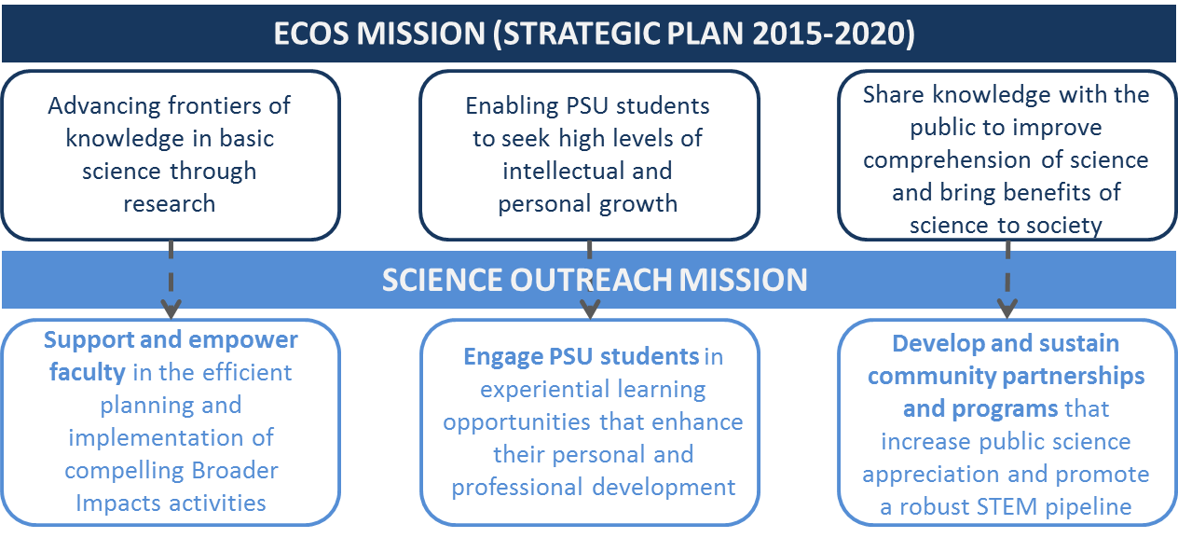
BIRC: Purpose and Development
Links to our office’s mission to support ECoS faculty and graduate students in their Broader Impacts activities
Current iteration of BIRC developed after interviewing ECoS graduate students and faculty about their needs:
Quick guidelines on what NSF expectations are for Broader Impacts
Successful Broader Impacts examples
Available options for Broader Impacts activities

Slide 3
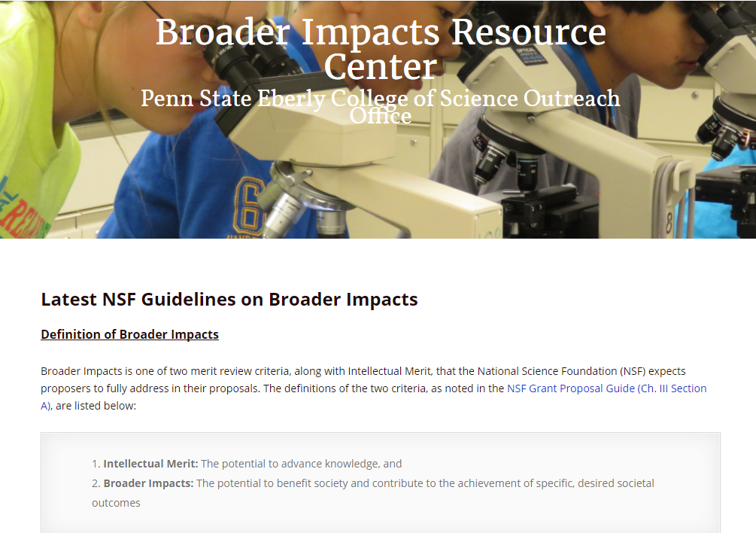
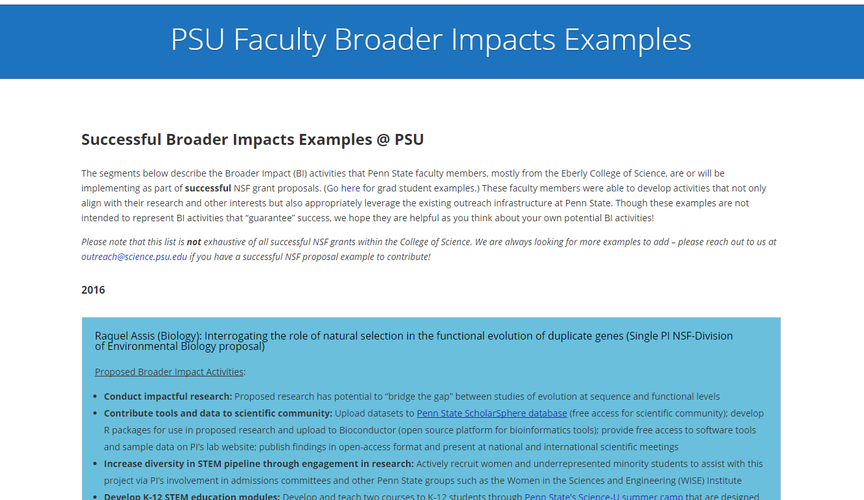
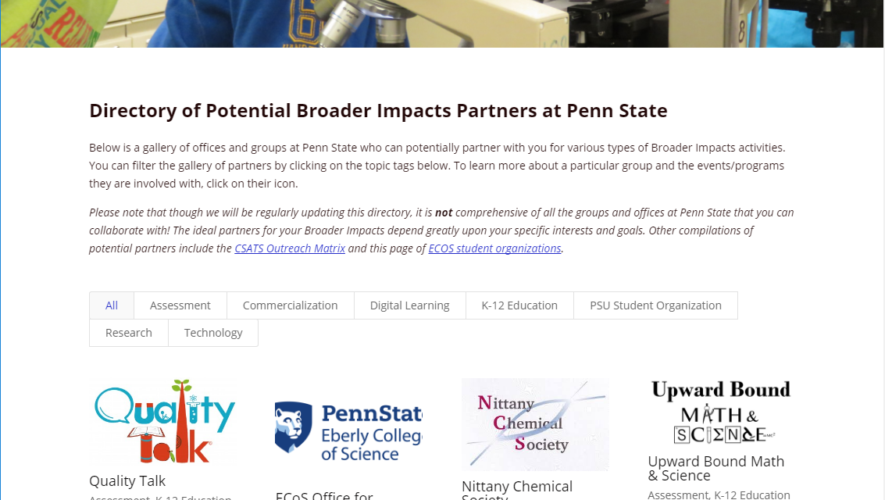
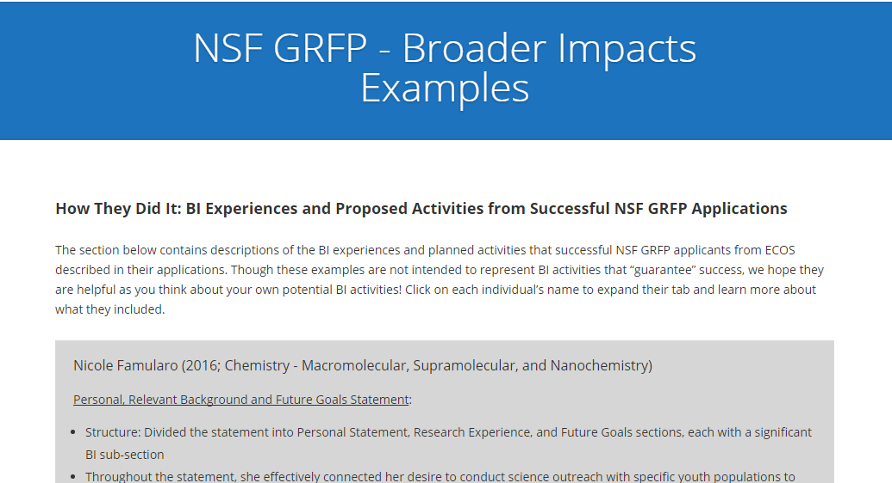
BIRC: Key Features
broaderimpacts.psu.edu
NSF Guidelines on Broader Impacts
Successful BI Examples (Faculty and GRFP)
Broader Impacts Partner Directory
NSF BI definition and requirements (as listed in Grant Proposal Guide)
NSF review process and trends (as described by faculty who have served on review panels)
Most viewed page (337 unique visitors, 559 views in last year)
Summaries of Broader Impact sections from successfully funded NSF grants
Get names of successful grantees from Research Office (faculty) and NSF GRFP website, request BI sections via email and vet summary with author
Profiles of different Broader Impacts partners:
Provide overview of partner activity
Describe key programs/services
Provide guidance on how to collaborate + past examples

Slide 4
Future Development: Plans and Ideas
Develop regular update cycles for key pages (e.g., NSF Guidelines on Broader Impacts, Successful Grant Examples)
Conduct analyses on examples to identify commonalities/ trends
Potential Areas for Collaboration:
Identifying NSF reviewers to provide process/trends updates, differentiate between directorates/divisions
Contributing content such as grant examples and BI partner profiles (BIRC Working Group?)
Ideas for other potential pages or features – how can the BIRC facilitate and improve Broader Impacts collaboration and activity?

