Slide 1

Search Committee Training
Human Resources
307 Agricultural Administration Building
University Park, PA 16802
814-863-3452
HUMAN RESOURCES
College of Agricultural sciences

Slide 2

Hiring Information
Visit the College of Agricultural HR website to review
Hiring Procedures for the College of Ag

Slide 3
Training Highlights
Note: This Search Committee Training is required for staff, faculty, and postdoctoral scholar searches. It is not required for part-time vacancies.
Slide 16: Interview Questions Not Permitted
Slide 17: Interview Methods
Slide 18: Documenting Interview Notes
Slide 19: Interview Scorecard
Slide 20: Conducting Reference Checks
Slide 21: Items to Submit to HR Talent
Acquisition Team
Slide 22: Initiating the Hire
Slide 23: Background Checks for New Hires
Slide 24: Notifying Applicants Not Hired
Slide 25: Helpful Resources
Slide 26: Maintaining Confidentiality
Slide 27: Contacting Your Ag HR Consultant
Slide 4: Search Committee Requirements
Slide 5: Advertising
Slide 6-7: Viewing Applications in Workday
Recruiting
Slide 8: Resume Scorecard
Slide 9: Be Aware of Unconscious or Implicit Bias
Slide 10: Reviewing Applications for Minimum Qualifications
Slide 11: Reviewing Applications for Red Flags
Slide 12: Selecting Candidates for Interviews
Slide 13: Diversity Review
Slide 14: Inviting Candidates to Interview
Slide 15: Developing Interview Questions

Slide 4






Search Committee Requirements
The search committee should have gender and race/ethnicity representation.
The search committee should consist of at least three members. An odd number of members is recommended.
A list of search committee members should be sent to your assigned Ag HR Consultant to ensure each search committee member has reviewed the search committee materials.
Prior to meeting with candidates, each search committee member must review this slideshow and visit the webpages linked within.
The search committee for a faculty position must be approved by the Dean’s Office.
An Academic Recruitment Form* must be completed for faculty searches if the Affirmative Action Office determines that the department is underrepresented. If the form is required, one will be sent by Penn State HR Shared Services to the search committee chair.
  *outlines department representation and search committee composition

Slide 5

Advertising
Advertising is not required for staff positions (other than Extension Educators). However, advertising will result in a larger and more diverse pool of candidates.
Limited-Term vacancies require advertising in one external source beyond the Penn State Jobs website.
Tenure-track vacancies require advertising in one publication of national distribution. In addition, if you suspect your full-time tenure-track faculty position may attract highly qualified foreign national candidates, then please follow these important guidelines: Recruitment Requirements for International Faculty New-Hires.
Advertising outlets for faculty positions must be approved by the Dean’s Office.
Before advertisements can be placed in publications or sent to listservs, advertisements and position vacancy announcements must be approved by Talent Acquisition.
Hiring managers should consider publications that will reach diverse populations:
      AsiansInHigherEd.com
      BlacksInHigherEd.com
      HispanicsInHigherEd.com
      LGBTinHigherEd.com
      VeteransInHigherEd.com

Slide 6
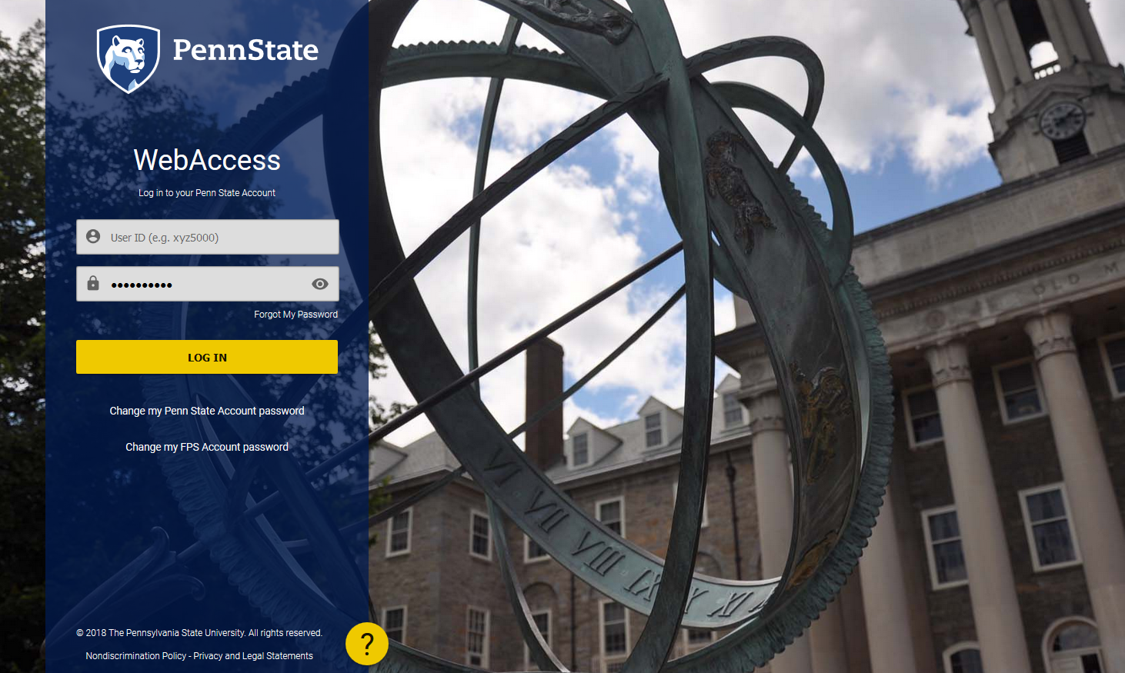
Viewing Job Applications and Resumes in Workday Recruiting
Upon completion of this one-time training, search committee members will receive access from Talent Acquisition to view job applicants and their submitted materials.
The applicants can be found in Workday Recruiting.
Step 1: Sign in with your access account or Friends of Penn State account.

Slide 7
Viewing Job Applications and Resumes in Workday Recruiting
Once you’re in Workday, you can search for your job requisition.
In the Applications section of your Workday homepage, click Recruiting Dashboard. On the right-hand side of the screen, you will find the Candidate Pipeline section.
Scroll to find the Job Requisition (e.g., REQ_000000XXXX Job Title) you want to review.
Alternatively, if you know the job requisition number, you can search for it in the search bar by entering the prefix JR: and the requisition number (e.g., JR:000000XXXX)
Click on your selection to be taken to the job requisition homepage.

Slide 8
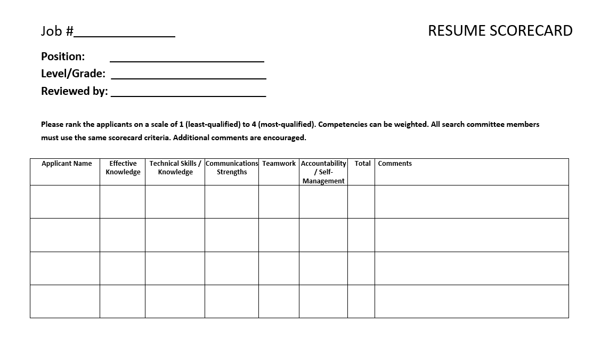

Slide 9
Be Aware of Unconscious or Implicit Bias
Being aware of an unconscious or implicit bias is the first step to ensuring that each search supports and furthers Penn State’s goal of building a more diverse and inclusive workforce. Such biases can be a factor in the review of applicant materials as well as in subsequent phone and in-person interviews.
  Affinity Bias: the tendency to think positively about an individual like yourself
  Halo Effect: the tendency to see one great thing about a candidate and, as a result, assume that everything about that candidate is positive
  Horns effect: the tendency to focus on one particularly negative feature about a candidate, which clouds your view of that individual’s other qualities
  Confirmation bias: the tendency to seek information that confirms pre-existing beliefs or assumptions about an individual
  Conformity Bias (Group Think): the tendency to mimic others’ beliefs or hold back your own thoughts and opinions about a candidate

Slide 10


Reviewing Applications for Minimum Qualifications
Review candidate qualifications against the minimum qualifications specified for the job.
Consider only those candidates who meet the minimum qualifications.
For staff positions, a candidate’s relevant experience may be considered if that candidate lacks the required degree:
Equivalent Experience for Degree Required*
  associate degree = 4 years of relevant experience
  bachelor’s degree = 8 years of relevant experience
  master’s degree = 12 years of relevant experience
Example: If a position requires a master’s degree plus three years of relevant experience, but the candidate does not have a master’s degree, they could meet the minimum qualifications with:
  bachelor’s degree plus 7 years of relevant experience, or
  associate degree plus 11 years of relevant experience, or
  high school diploma plus 15 years of relevant experience
*Please note: Applying relevant experience in lieu of a degree does not apply to academic positions.

Slide 11

Reviewing Applications for Red Flags
Things to look for on resumes and applications:
  How long has the applicant been in previous positions?
  Is there frequent movement from one job to another?
  Why did the applicant leave his/her last job?
  Are there any red flags?
  Are there long breaks in employment?
  Ask about these breaks when interviewing the applicant.
  Is the applicant legally permitted to work in the U.S. without sponsorship?
  (Penn State will not support H-1B sponsorship for staff or part-time positions.)

Slide 12

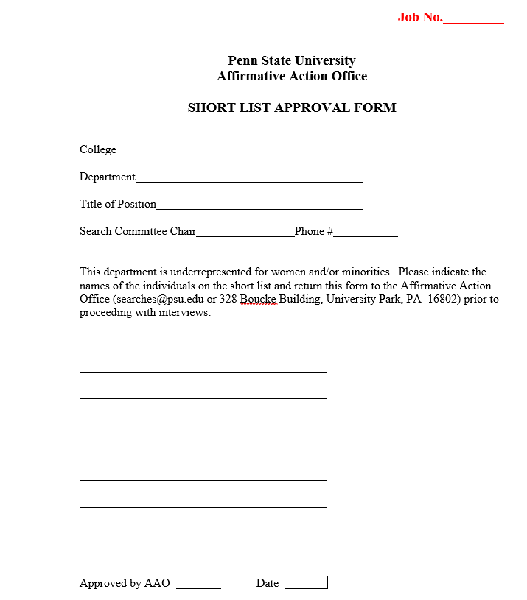

Selecting Candidates to Interview
Identify Top Candidates. The search committee creates a “short list” of the candidates to be interviewed.
For staff positions: Prior to scheduling interviews, the search committee will send the
short list to the assigned Ag HR Consultant for approval.
For faculty searches: Prior to reaching out to the applicants, the Department Head will
recommend to the Dean which candidates should be interviewed as outlined in the College Procedure for Filling a Tenure Track and Non-Tenure Track Faculty Position.
Faculty applicants must submit a letter of application (cover letter), curriculum vitae, academic transcripts, and a minimum of three letters of reference.
  The Affirmative Action Office requires a
  Short List Approval Form from departments
  that are considered underrepresented.

Slide 13

Diversity Review
For staff positions, a member of HR will review the short list for candidates of underrepresented groups and perform good-standing checks for internal candidates.
  If HR feels that a candidate from an underrepresented group is as equally qualified as those
  selected for interview by the committee, justification from the committee will be requested
  as to why the minority applicant was not selected for an interview.
  If non-discriminatory justification cannot be provided, the committee will be instructed to
  offer the minority candidate an interview.
  If candidates from underrepresented groups apply for a faculty position and are not among the finalists selected for interview, the department head will provide information to the Dean regarding their applications and the reasons they were not selected.
  Penn State’s Affirmative Action Policy
  It is the policy of the University to maintain an environment free of harassment and free of discrimination against any person because of age, race, color, ancestry, national origin, religion, creed, service in the uniformed services (as defined in state and federal law), veteran status, sex, sexual orientation, marital or family status, pregnancy, pregnancy-related conditions, physical or mental disability, gender, perceived gender, gender identity, genetic information, or political ideas.

Slide 14



Inviting Candidates to Interview
When the time has come to reach out to the candidates about interviewing, consider incorporating the following into the communication:
  Reasonable Accommodation – Ask the candidate if accommodations are needed for a phone
  call, Zoom session, or face-to-face interview.
  Chosen Pronoun – Ask the candidate for a chosen pronoun to ensure that communication to
  the search committee and department/unit aligns with the candidate’s gender identity.
  Dietary Restrictions – If the interview will involve food, ask the candidates if they have any
  dietary restrictions.
  Salary (Staff Positions Only) – You may alert the candidate to any salary limitations that might
  exist to ensure that the salary meets the candidate’s expectations. Having this conversation
  before an interview, rather than at the end of the hiring process, will help you and the
  candidate avoid wasting time on a salary that is too low. (Ask your assigned Ag HR Consultant
  for a realistic salary within the approved band that you can communicate to the prospective
  interviewee.)

Slide 15

Developing Interview Questions
Before the interviews, the search committee will:
Develop a list of job-related questions to ask each candidate.
  Utilize behavior-based questions to identify which candidates possess the
  traits and characteristics that you believe are essential for success in the job.
  Avoid using yes-or-no questions as they inhibit your ability to collect critical
  information about the candidate by which you will make your hiring decision.
  Provide a copy of the interview questions to Talent Acquisition talentacquisition@psu.edu for the Affirmative Action file (see slide 22).
Consult with your assigned Ag HR Consultant if you wish to utilize pre-
employment testing and assessments during the interview process.
During the interview, the Search Committee will:
Keep questions focused on the required competencies, knowledge, abilities,
qualifications, and experiences of the candidate.
USE THE SAME INTERVIEW QUESTIONS FOR ALL CANDIDATES.

Slide 16
Questions Not Permitted in an Interview
The following topics are off-limits and must be avoided during an interview:
      arrest record
      less-than-honorable military discharge
      gender
      marital status, spousal information (name, education, income)
      number and ages of children, childcare management, family plans
      place of birth/citizenship
      English-language proficiency (speaking, writing), unless required by the job
      other languages spoken, unless required by the job
      disabilities, handicaps, prior illnesses and accidents
      age or date of high school graduation
      weight
      religion/church affiliation
      participation in social organizations

Slide 17
Interview Methods
Screening Interview
This first-round interview is conducted to determine whether the
applicant has the necessary qualifications.
Phone Interview
Skype/Zoom Interview
Remember to discuss accommodations with the interviewee (slide 15).
Candidate Presentation
You must obtain written approval from an interviewee before recording
a presentation (see slide #19)
In-Person Interview
Please note: All candidates must be offered interviews via the same method.

Slide 18

Documenting the Interview
For staff positions, an interview scorecard (see slide 20) should be used to document the interviews. The score cards should contain only job-related information. Do not include personal information.
Interview notes are legal documents and must be submitted to Talent Acquisition at talentacquisition@psu.edu for the Affirmative Action file (see slide 22).
Recording interviews is not permitted unless all parties to the conversation have consented:
Two-Party Consent Law
AD53 University Privacy Policy
Pennsylvania Wiretapping Law
  Failure to abide by these laws and policies can result in criminal penalties and termination of employment.

Slide 19
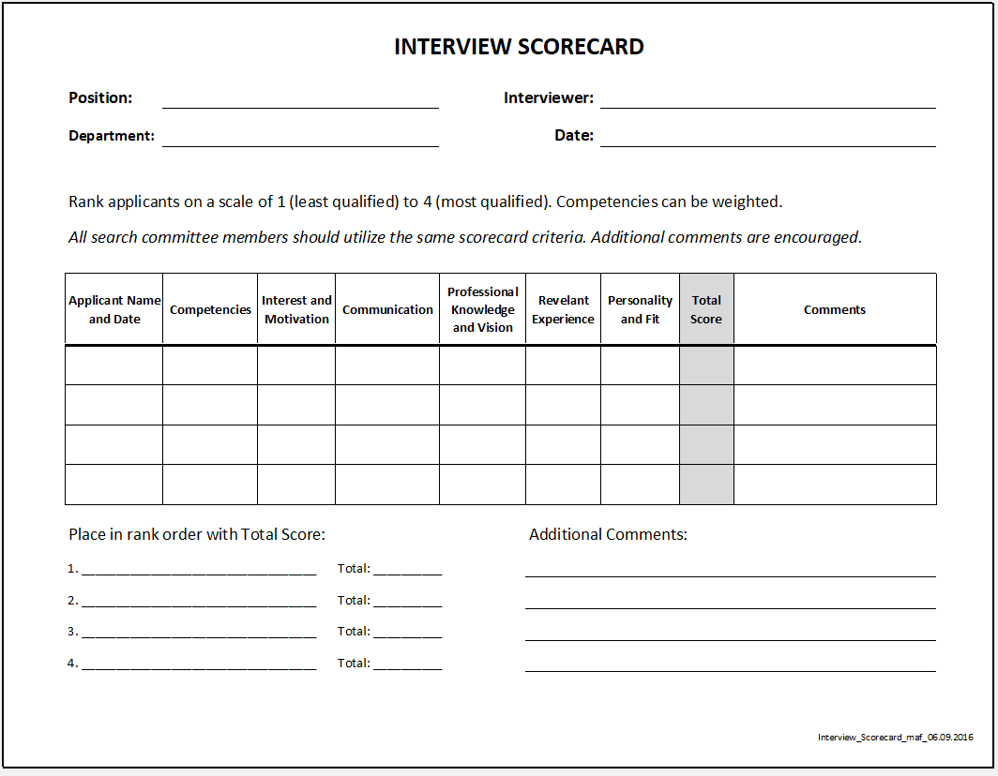

Slide 20
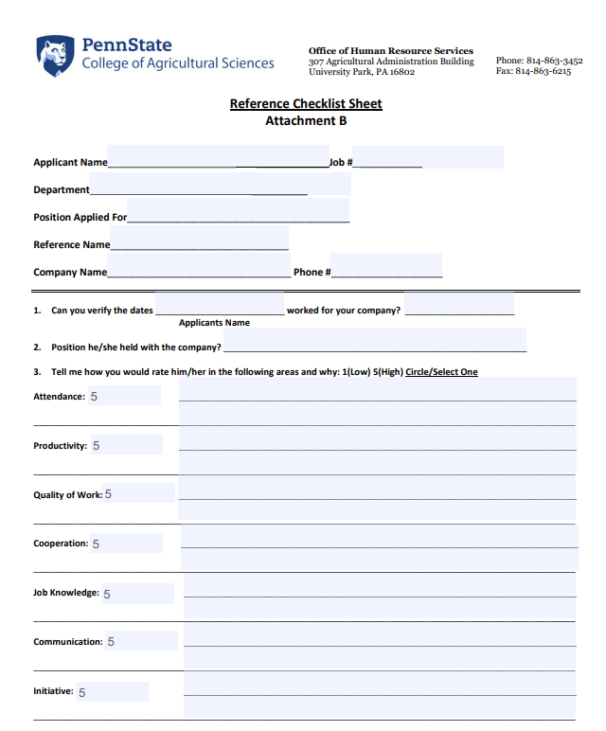
Conducting Reference Checks
Following interviews, conduct reference checks on the top candidate(s) only.
    Reference checks should be completed by search committee chair.
    Reference checks are required for both internal and external applicants.
    Letters of reference are required for faculty positions.
Check at least three references, with an emphasis on the current supervisor and former employment/professional references over personal references.
Reference check information should be forwarded to Talent Acquisition (see slide 21).
Use the Reference Checklist Sheet or your own reference checking tool to record the information gathered.

Slide 21
Items to Submit to Talent Acquisition
For Staff Positions, send the following interview materials to Talent Acquisition at talentacquisition@psu.edu :
  resume scorecard and interview scorecard for each person interviewed
  a copy of your interview questions
  reference check information on your top candidate(s)

Slide 22
Initiating the Hire
Upon selecting the most qualified applicant, the search committee chair will work with the appropriate department (Ag Human Resources for staff positions, Dean’s Office for academic positions) to extend an offer.
The Hiring Manager will move selected candidate to hire to initiate the hire.
Affirmative Action information will be recorded by HR Shared Services in the jobs system to produce an Affirmative Action report; therefore, it is critical that they receive this information from the committee.

Slide 23

Background Checks for New Hires
Every new hire* will complete a standard background check through our vendor, First Advantage.
All new hires that will have direct contact with minors,* as defined in Policy AD39, are required to obtain the three publicly available clearances in lieu of a standard background check.
    Clearances include:
      Pennsylvania State Police Criminal Background Check
      Pennsylvania Child Abuse History Clearance
      Federal (FBI) Fingerprint Background Check
Some positions may also require additional checks, such as a motor vehicle record (MVR) check, education check, or credit check. These will be processed through First Advantage.
Please note: Background checks are a condition of employment.

Slide 24
Notifying Applicants Not Hired
The search committee chair must contact all the candidates who were interviewed, but not selected, to inform them of the committee’s decision.
Applicants who were in the pool but not granted an interview will be notified via an email generated by Workday Recruiting when the job has closed. The search committee is not responsible for contacting these individuals.

Slide 25
Helpful Resources
  Staff (Non-Academic) Hiring Information
  Affirmative Action Office’s Ensuring Equitable Searches for Staff Positions
  Faculty (Academic) Hiring Information
  Office of the Vice Provost for Faculty Affairs best practices for interviewing candidates: https://www.vpfa.psu.edu/files/2021/02/Faculty-Searches-during-COVID_02.3.21.pdf
  Postdoctoral Appointment Hiring Information
  Background Check Information
  Affirmative Action Office
  Extension Hiring Procedures: Available on Extension’s SharePoint site

Slide 26

Maintaining Confidentiality at All Times
Search materials are confidential:
applicant information and materials
individuals selected for interview/position
specific evaluation methods and questions
committee discussions regarding candidates

Slide 27
Contacting Your Assigned Ag HR Consultant
  Please contact your assigned Ag HR Consultant if you have any questions regarding this search committee training.
  Let your assigned Ag HR Consultant know when you have reviewed the Search Committee materials so that your eligibility to serve on search committees can be recorded.
Thank you for reviewing the College of Agricultural Search Committee materials.

